Slide 1

PAD-US PRESENTATION FOR
NASORLO
USGS Gap Analysis Program
September 16, 2016

Slide 2
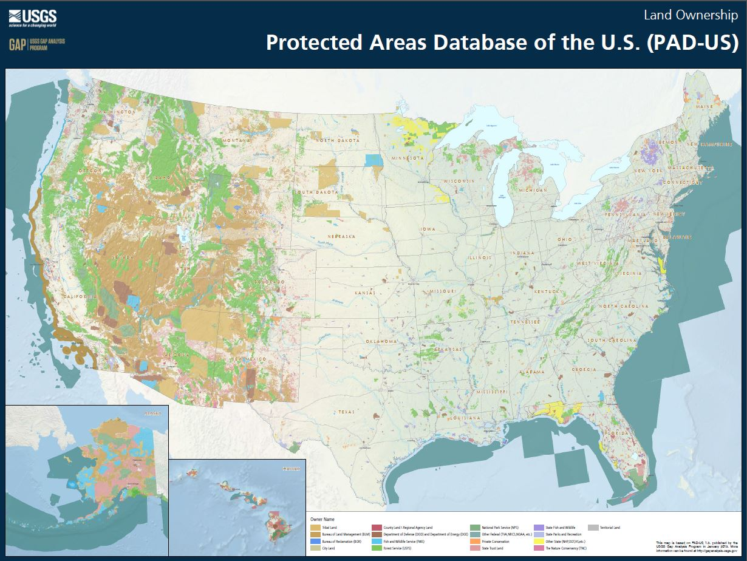
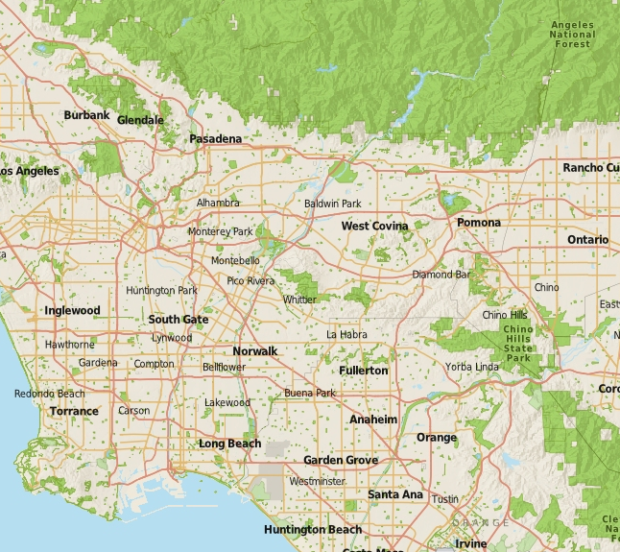
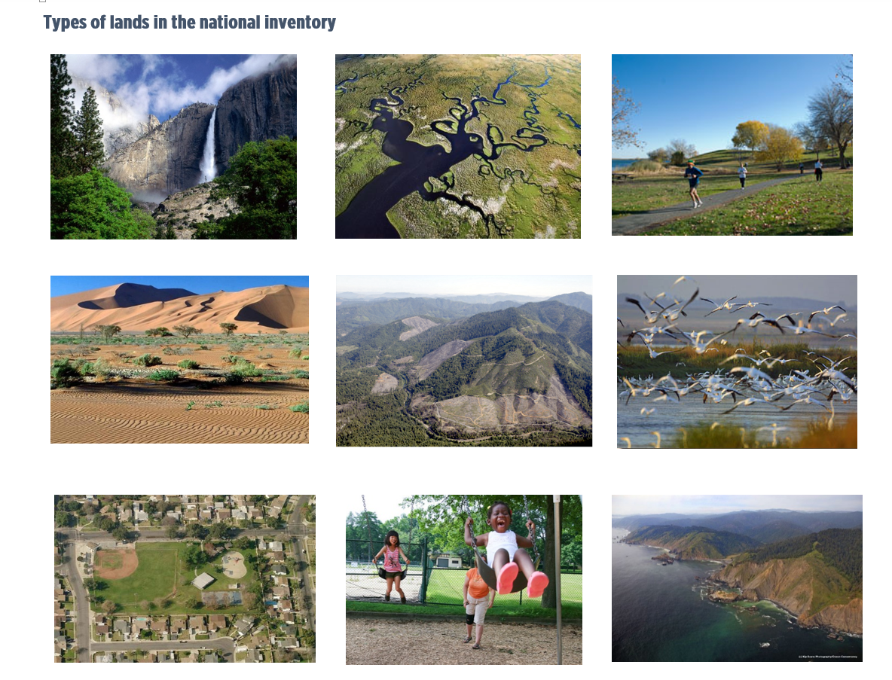
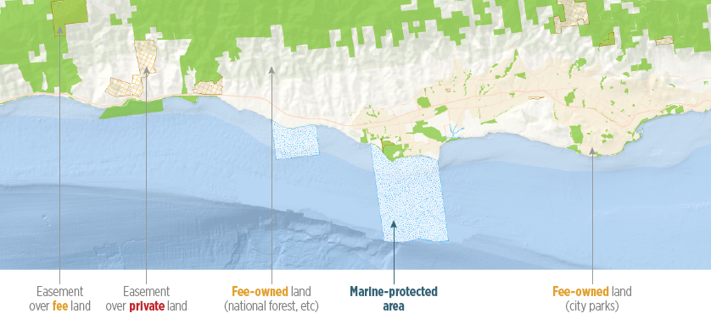
PAD-US
Protected Areas Database of the U.S
GIS database of parks and other lands
Published by USGS
Federal, state, local and NGO owned lands, plus marine areas
Mostly done for fed, state; need more local data
3 billion acres, 20,000+ agencies
1

Slide 3
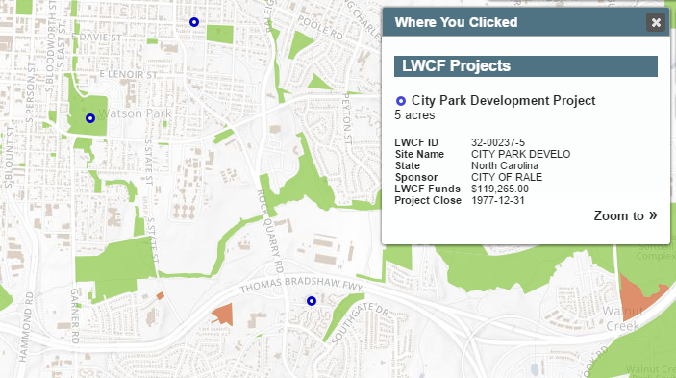
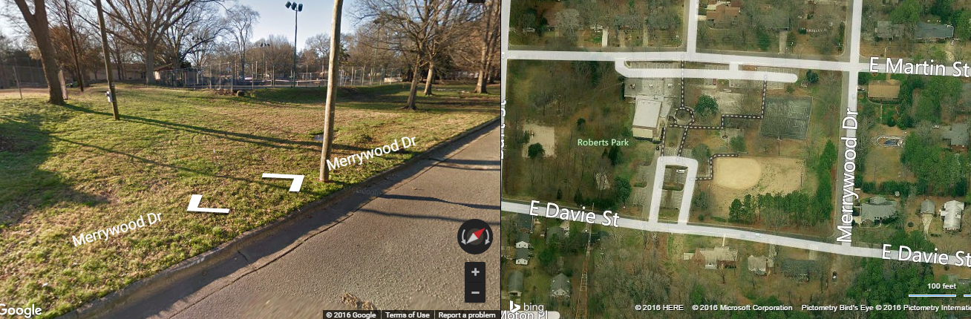
LWCF and PAD-US
LWCF project locations should be inside PAD-US park boundaries, (unless located elsewhere)
Good park boundaries can lead to 6f review tools
2

Slide 4
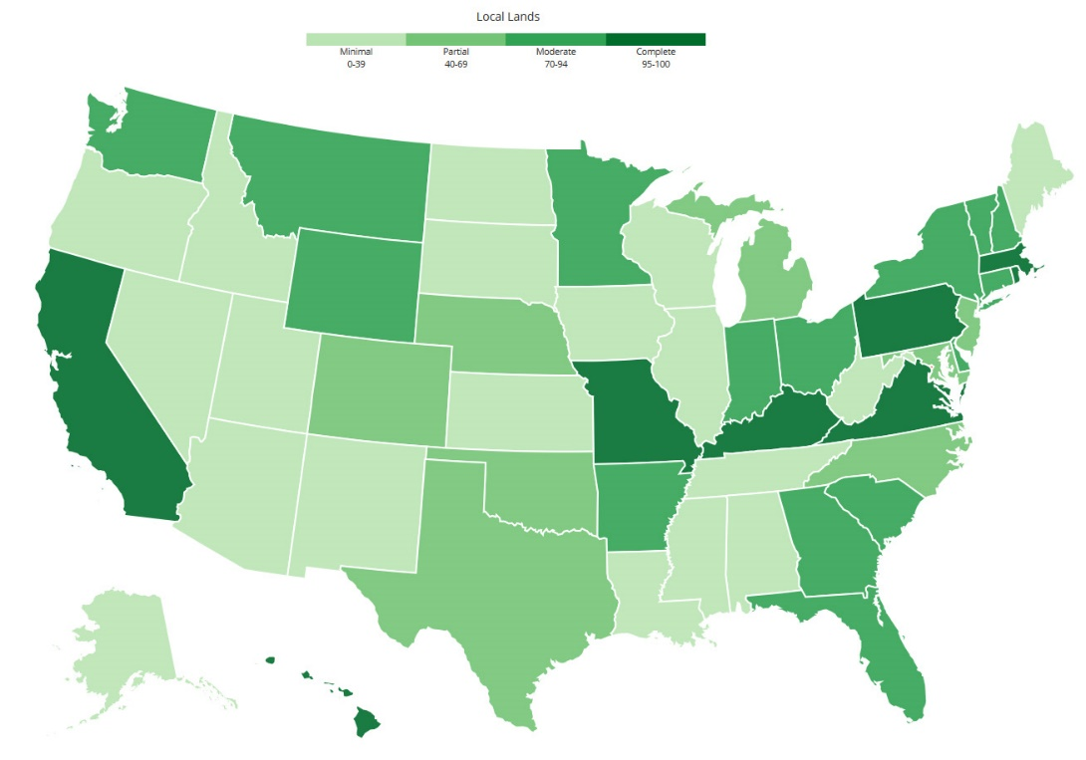
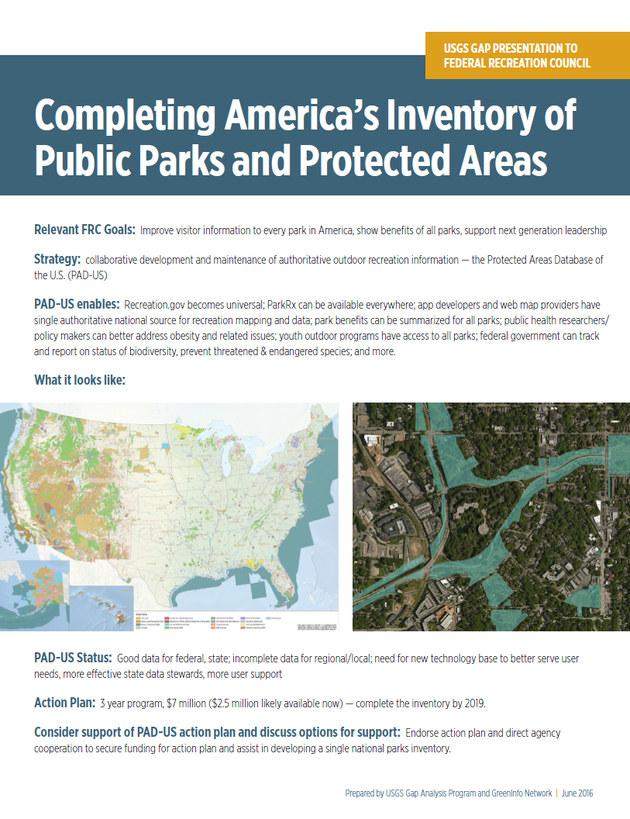
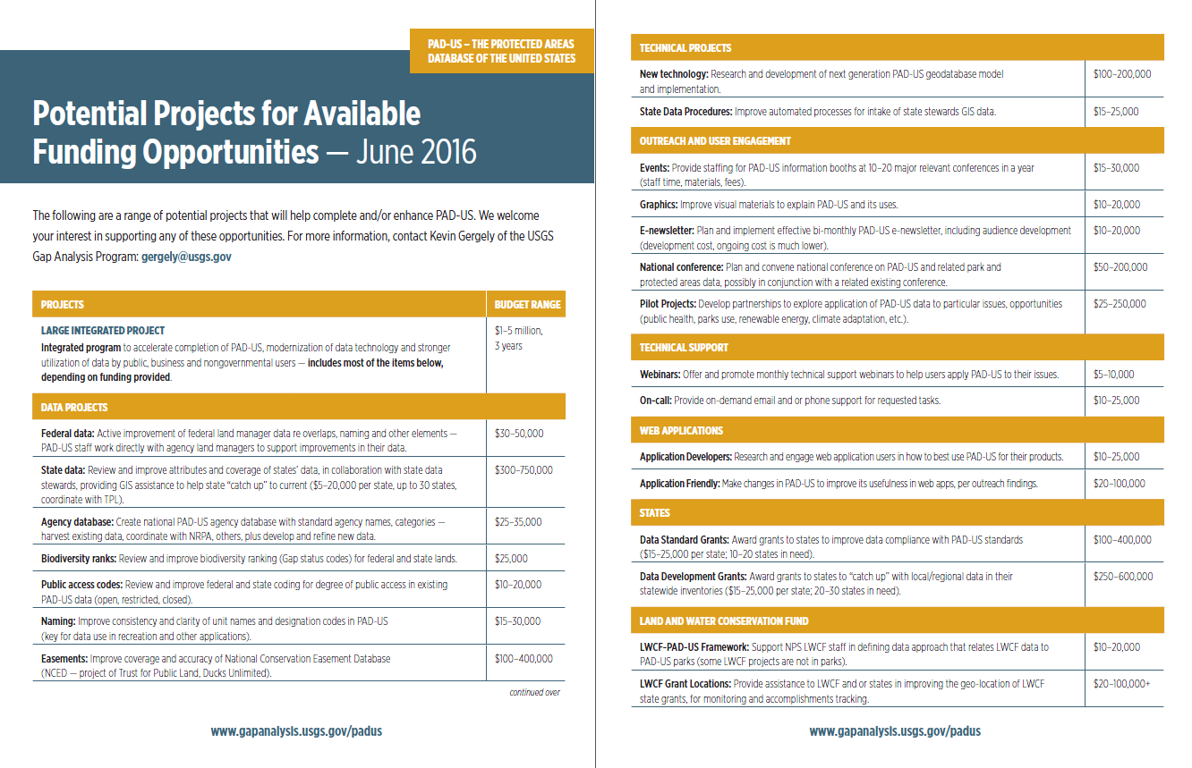
PAD-US Status
A dozen states mostly complete, but most missing local and regional park lands
Completing PAD-US requires a focused, 3 year effort
Efforts underway to secure support for that action agenda
3

Slide 5
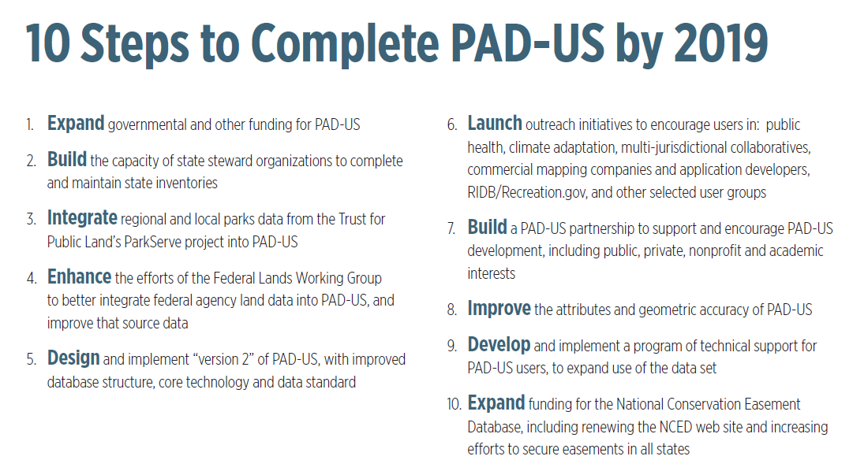
What NASORLO Can Do – Endorse this action plan
4

Slide 6

Gap Analysis Program
gapanalysis.usgs.gov
Lisa Johnson
PAD-US Coordinator
LisajJohnson@boisestate.edu
5

