Slide 1

Arkansas procedure for Project Boundary Maps
Project boundary maps are created in-house for both LWCF- and state-funded Matching Grant projects

Slide 2

Upon Submission of Application:
Look
Look at the project boundary map, locus map, and deed that the applicant provides with application
Locate on
Locate on satellite image based adjacent street, landmarks, etc.
Plot
Plot polygon map base on legal description (metes and bounds, lot/block, etc.).
Compare
Compare polygon with satellite imagery
Compare
Compare with any previous project boundary maps
Compare
Compare with parcel data
Compare
Compare with county records and/or parcel data.
Verify
Verify encumbered area and that no non-conforming elements are within the project boundary

Slide 3

Upon Grant Award:
Enter
Enter polygon in a DRAFT GIS layer
Create
Create DRAFT project boundary map to be verified by grantee
Signature
Once verified, signature line is put on project boundary map for signature as part of the contract with the state
Verify
After project completion, verify that there are no changes including withdrawal or removing a site on a multi-site grant

Slide 4

Updating Project Boundary Maps
Project files of many previously-funded projects dating back to the mid-1960s have essentially unusable Project Boundary Maps.
Maps in project files are legal documents and, for LWCF projects, the only 6(f) boundary maps recognized by the NPS.
These maps are, in many cases, essentially useless for the purposes of compliance inspections and communication with project sponsors.

Slide 5
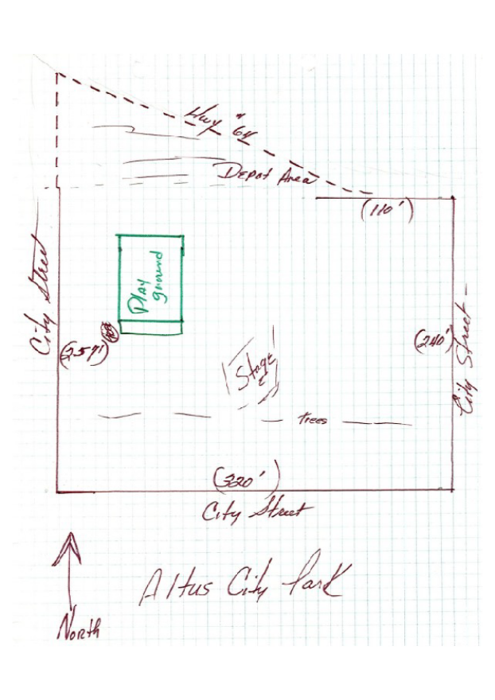
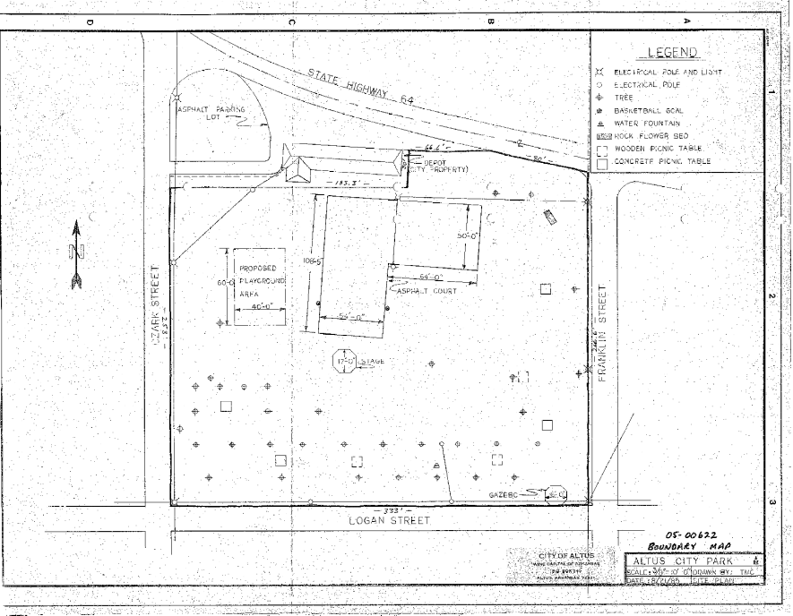
Examples of Original Project Boundary Maps
These maps of the same site were found in two grant project files

Slide 6

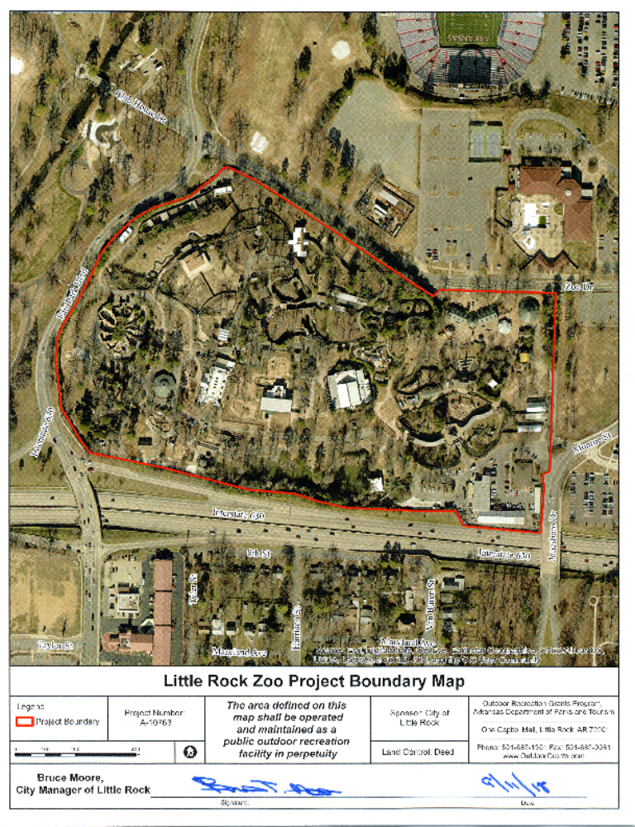
Updating State-funded Project Boundary Maps
Local official
signature line

Slide 7
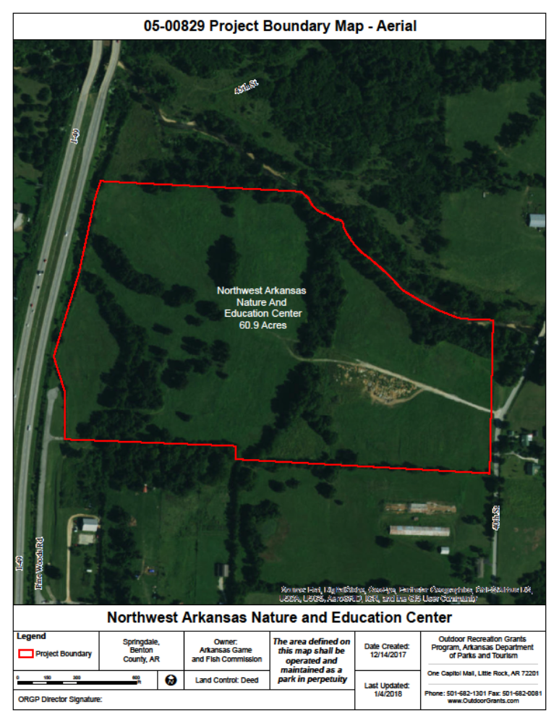
Creating LWCF 6(f) Project Boundary Maps for new projects
Program Director/
ASLO signature line

Slide 8
Creating Conversion Maps:
Determine location of conversion based on provided maps
1
Map polygon of converted area based on maps provided and aerial imagery
2
Check against county data and parcel data
3
Map out deeds if provided by the project sponsor and from previous grants
5
Reference previous boundary maps and refine polygon layer according to deed information
7
Refine converted area polygon according to the updated LWCF polygon layer and aerial imagery
8
Repeat previous steps as needed for the replacement property
9
Include converted and replacement polygons to GIS database and project files
10
Draft conversion maps and submit to NPS
11

Slide 9
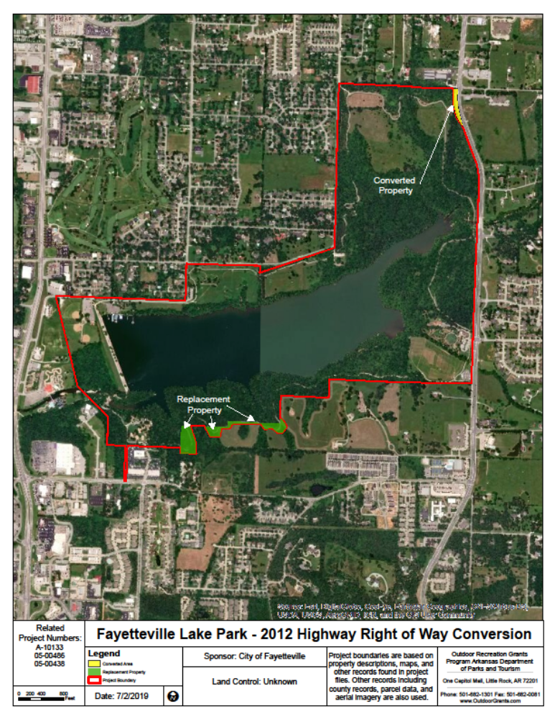
Post conversion 6(f) Project Boundary Maps

