Slide 1
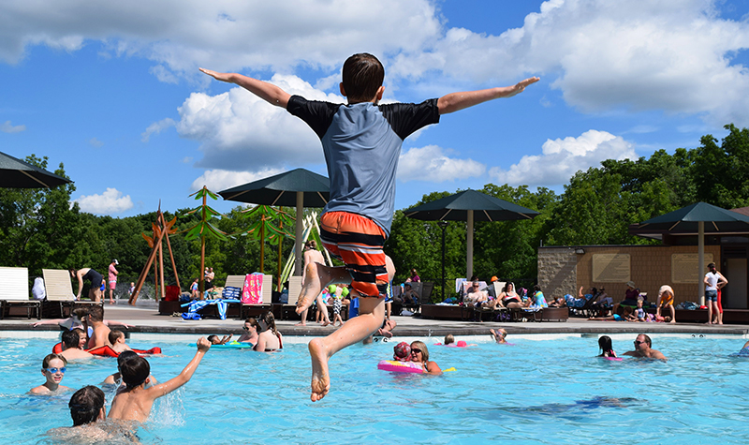
Conversions – Let’s Jump In!
Blue Mounds State Park, Wisconsin Photo credit: Ayers Associates
NASORLO Annual Meeting
October 8, 2019

Slide 2

What triggers a conversion?
  Property interests are conveyed for private use or non-public recreation uses
  Non-outdoor recreation uses are within the LWCF boundary
  Unallowable indoor facilities are developed within the LWCF boundary
  Public outdoor recreation use of property acquired and/or developed with LWCF assistance is terminated
Notes:
b. Non-outdoor recreation uses (public or private) are made of the project area, or a portion
thereof, including those occurring on pre-existing rights-of-way and easements, or by a
lessor.
c. Unallowable indoor facilities are developed within the project area without NPS
approval, such as unauthorized public facilities and sheltering of an outdoor facility.

Slide 3
Common questions and misconceptions
Pay back the money from the original grant?
Capital investment in lieu of replacement property?
de minimis for LWCF?
Obsolescence – Removes provisions?
Public agencies who cannot purchase replacement property – Exempt?
Conversion provision – Waivers?
Notes:
If a project sponsor cannot purchase property because of local political/policy reasons, they are still responsible for the conversion replacement.
Conversion requirements cannot be waived by contacting the Secretary of Interior

Slide 4
Conversions
(54 U.S.C. §200305(f)(3))
  No property acquired or developed with assistance under this section shall, without the approval of the Secretary, be converted to other than public outdoor recreation uses. The Secretary shall approve such conversion only if he finds it to be in accord with the then existing comprehensive statewide outdoor recreation plan and only upon such conditions as he deems necessary to assure the substitution of other recreation properties of at least equal fair market value and of reasonably equivalent usefulness and location.

Slide 5
Conversion Requirements
(36 C.F.R. §59.3)
    What are the highlights from these requirements that help?
    Practical alternatives evaluated
    Fair market value established
    Replacement property does not need to provide the same recreation experience nor does it need to be close to the converted site; One parcel can satisfy several approved conversions
    Replacement property meets the eligibility requirements for acquisition
    For partial conversions, the impact to the remainder shall be considered…..
Notes:
LWCF Act is the law and the regulations on this slide are rules created by the NPS that must be followed because they have the force of law

Slide 6
Conversion Requirements
(36 C.F.R. §59.3)
    …..highlights from these requirements that help?
    All coordination with other federal agencies had been accomplished
    Environmental review satisfactorily completed
    Intergovernmental clearinghouse review complete
    Conversion and substitution are in accord with the SCORP

Slide 7
First Steps
  Consult with your NPS Project Officer
  Confirm LWCF boundary for the site
  Decide the conversion footprint
  Identify potential replacement property
  Determine eligibility of replacement property
  Develop general concept plan
  Order appraisals
Notes:
Consult with NPS to confirm Section 6(f)(3) park boundary (from previously funded LWCF projects and NPS grant files), whether the proposed activity is within NPS’ jurisdiction, and whether the proposed activity requires further NPS involvement.
Coordination meeting with STATE and NPS to discuss size and type of conversion and next steps. (Agreement on conversion footprint must take place prior to proceeding with NEPA, NHPA, appraisals, etc.).
Appraisals
Appraisal for converted property (should be completed first to determine fair market value of converted property and to determine how much replacement property will be required).
Appraisal for replacement property. The fair market value of the replacement property must be of equal or great in value as the converted property.
Appraisals for converted and replacement properties must comply with the Uniform Appraisal Standards for Federal Land Acquisitions (“yellow book”).
Appraisals must be reviewed by an independent appraisal reviewer.

Slide 8
State Responsibilities
Serve as point-of-contact for local sponsor, if applicable
Discussion with NPS to determine the conversion footprint and eligibility of replacement property
Appraisals (according to UASFLA) or waiver valuations
Consultation for Section 106 / SHPO review
Prepare conversion package, which includes:
  Cover letter
  PD-ESF
  Amendment form
  Updated 6(f) map
  DNF
Notes:
Consultation for Section 106 - NPS makes the final agency determination.

Slide 9
NPS Responsibilities
Complete negotiations about the conversion footprint
Evaluate eligibility of proposed replacement property
Initiate tribal consultation for Section 106
Assist the State in determining the appropriate NEPA pathway from an Environmental Screening Form
Review draft conversion package and provide technical assistance
Review final package, execute grant amendment

Slide 10
Types of Conversions
Standard Conversion
Small conversion
  No more than 10% of the whole LWCF recreation area
  Replacement property must be contiguous with the current site, or another existing park or recreation area, and otherwise meets the eligibility requirements for an acquisition grant
Conversions with delayed replacement
Notes:
Standard Conversion
Approvals completed prior to conversion
Replacement property provided at the time of conversion
After-the-Fact Conversion
Same requirements apply

Slide 11
Conversion Opportunities
    Replacement property does not need to provide the same recreation amenities and it may not need to be in close proximity to the converted site but must be equivalent
    Environmental, archeological, and other reviews completed for other federal programs [e.g. FEMA, FHWA] may be utilized for the LWCF NEPA review, if they meet LWCF standards
    One replacement parcel may satisfy several approved conversions

Slide 12
Best Practices and solutions
Timing: start early; manage expectations, especially when working with local sponsors
Land acquisition: When acquiring property w/ non-federal funds, evaluate possibility of using the property as replacement for identified conversions
Look for in-holdings as replacement property
Identify property already owned but not previously acquired or dedicated for park purposes
Notes:
Managing expectations – timeline is determined also by project sponsor and all the factors that go into a conversion
Identify property already owned but not previously dedicated for park purposes
Vacated road, purchased by project sponsor for something other than park use

Slide 13

Questions?
Your fellow SLO/ASLOs are an outstanding resource to tap when you are facing a difficult conversion. Reach out!
Crescent Harbor Playground; Sitka, Alaska Photo credit: www.gametime.com

