Slide 1
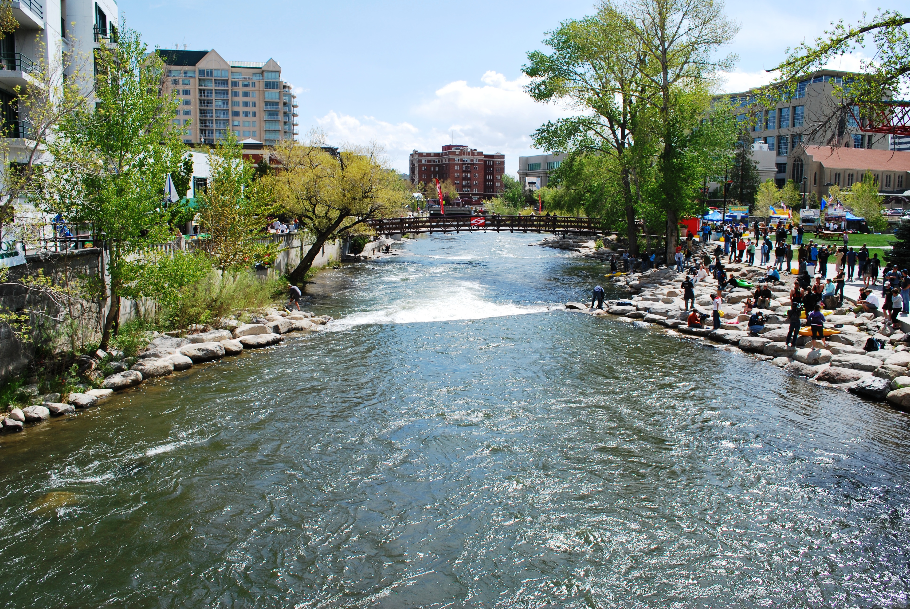

FORMS FORMS FORMS
2019 NASORLO CONFERENCE
Reno, Nevada

Slide 2
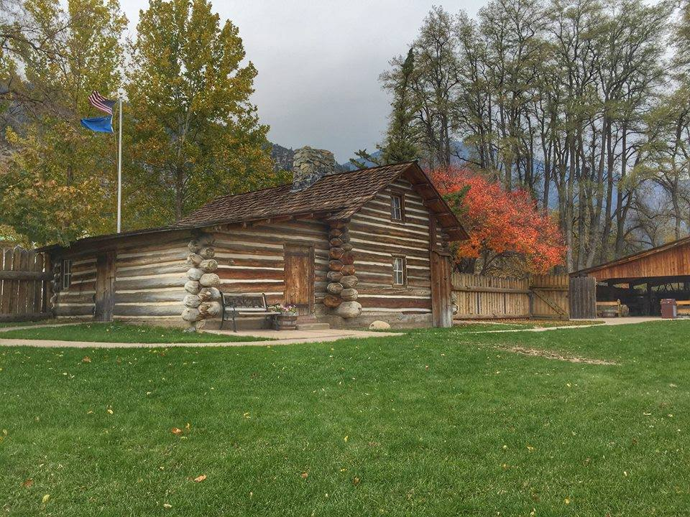

Overview
PD/ESF
Detailed Budget Narrative Examples
DNF
SF 424 Suite
  424
  424A
  424C
Questions
NATIONAL ASSICATION OF STATE OUTDOOR RECREATION LIASON OFFICERS NASORLO.ORG

Slide 3
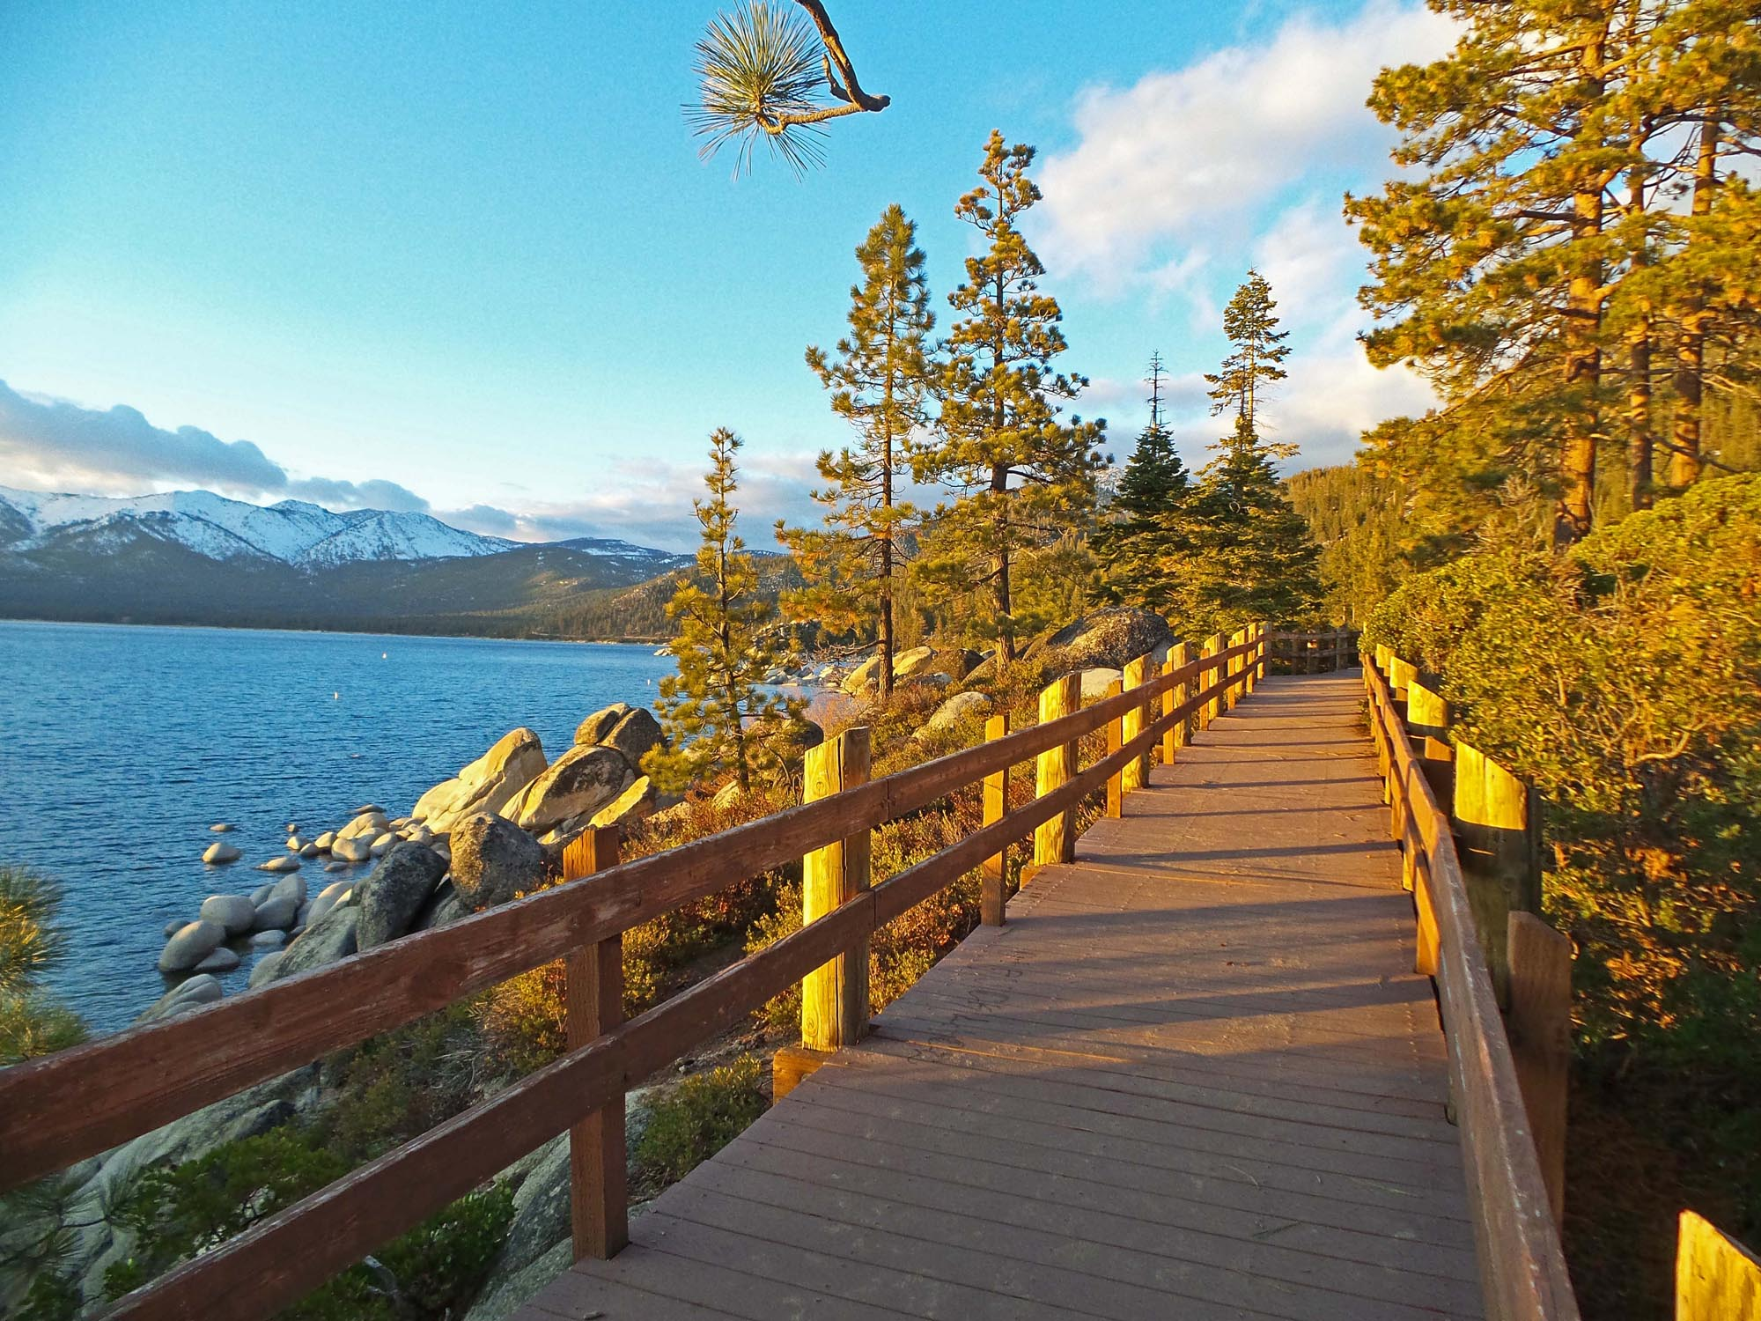
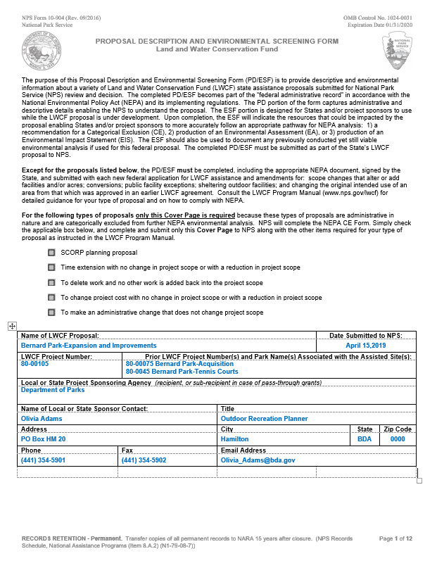
PD/ESF
Use the correct PD/ESF form
  OMB # 1024-0031
  Expires 01/31/2020
Prior LWCF projects should only include grants located at the same park that are or will be part of the 6(f) map.
Change color of entered text
NATIONAL ASSICATION OF STATE OUTDOOR RECREATION LIASON OFFICERS NASORLO.ORG

Slide 4
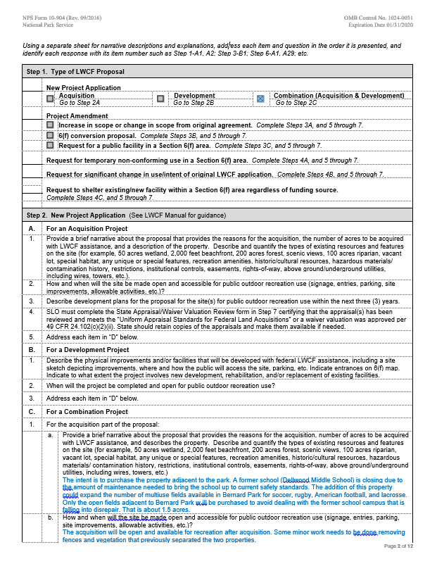
PD/ESF
Project narratives (for all types of projects) should be brief but detailed enough for someone to understand the project for the first time.
NATIONAL ASSICATION OF STATE OUTDOOR RECREATION LIASON OFFICERS NASORLO.ORG

Slide 5
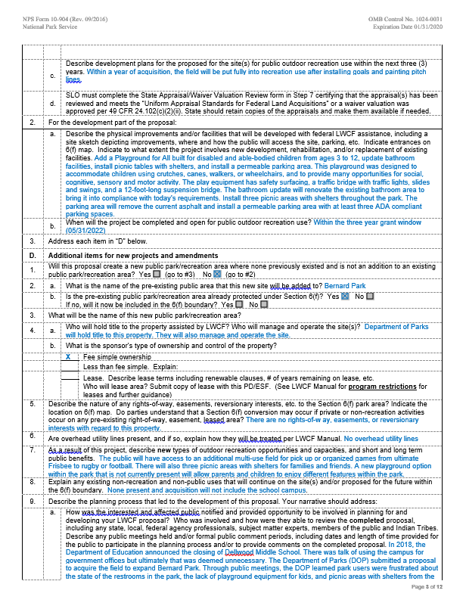
PD/ESF
Make sure that you are descriptive and thorough in explaining any rights-of-way or revisionary interests. Those listed here should also be noted on your 6(f) map.
NATIONAL ASSICATION OF STATE OUTDOOR RECREATION LIASON OFFICERS NASORLO.ORG

Slide 6
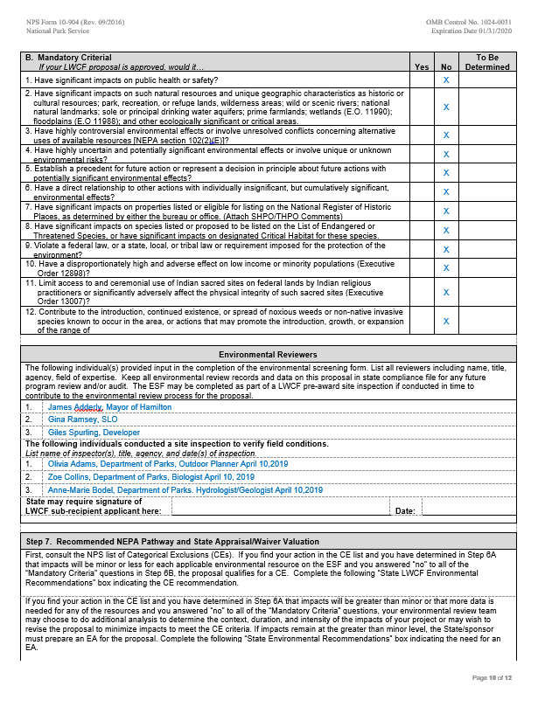
PD/ESF
The ESF should be completed by someone who is qualified in the field.
NATIONAL ASSICATION OF STATE OUTDOOR RECREATION LIASON OFFICERS NASORLO.ORG

Slide 7
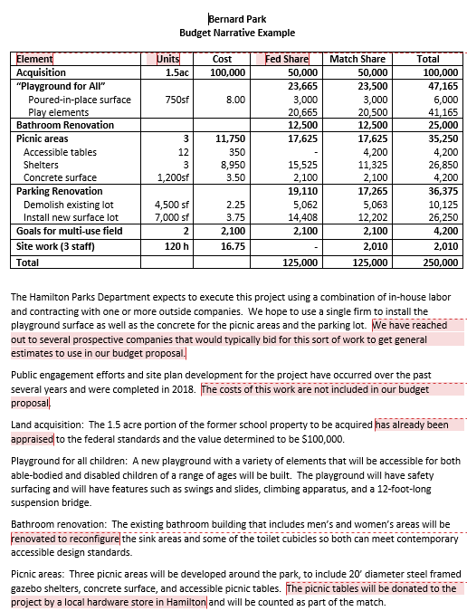
Detailed Budget Narrative
Answers questions before asked
How good is the estimate?
*companies asked; land appraised
Was work omitted from budget?
*not omitted, intentionally not included
How extensive is the renovation?
*reconfigure to meet ADA standards
NATIONAL ASSICATION OF STATE OUTDOOR RECREATION LIASON OFFICERS NASORLO.ORG

Slide 8
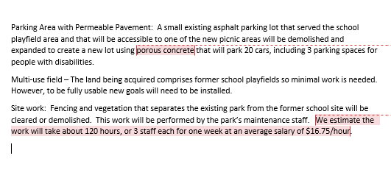
Detailed Budget Narrative- continued
What type of surface?
*porous concrete explains costs
How many staff and at what rate?
*estimate hours with breakdown
*average hourly rate provided
Great information for the COLD READER
NATIONAL ASSICATION OF STATE OUTDOOR RECREATION LIASON OFFICERS NASORLO.ORG

Slide 9
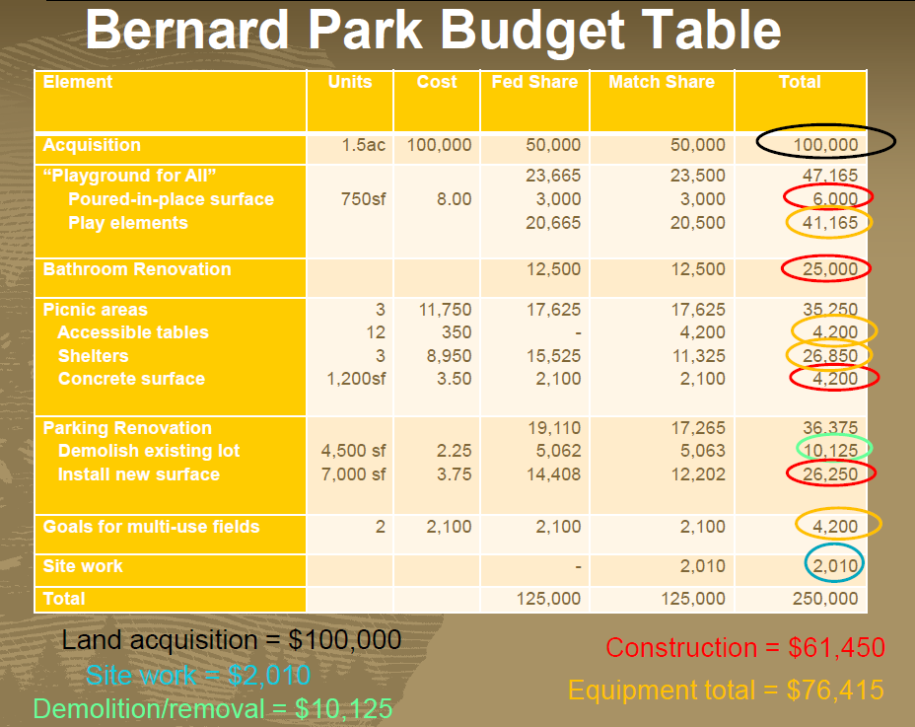
Detailed Budget Table
Acceptable
Practical
Element based
SF 424 C categories at bottom
Remain consistent
NATIONAL ASSICATION OF STATE OUTDOOR RECREATION LIASON OFFICERS NASORLO.ORG

Slide 10
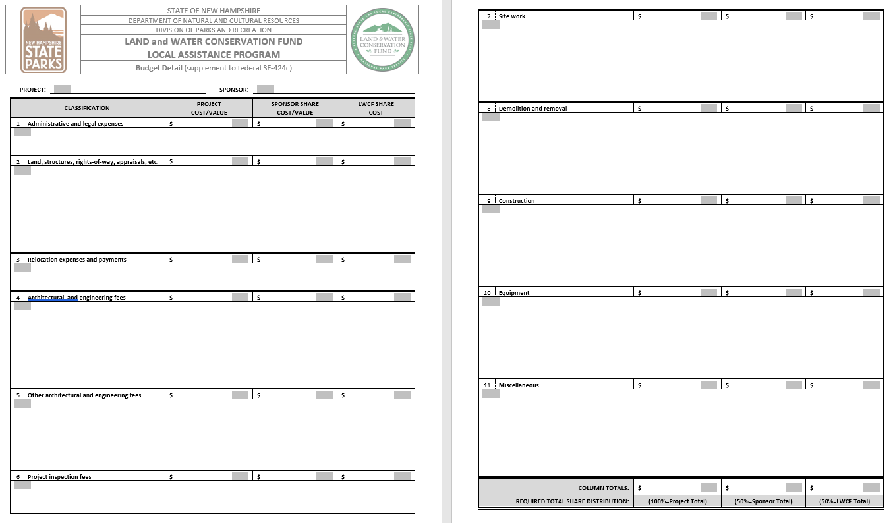
Detailed Budget Form - Example
NATIONAL ASSICATION OF STATE OUTDOOR RECREATION LIASON OFFICERS NASORLO.ORG

Slide 11
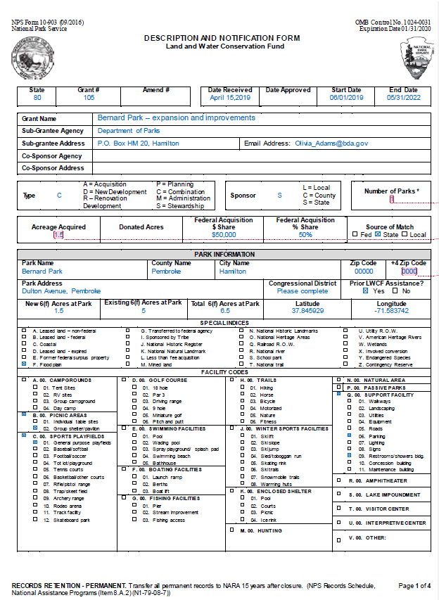
Description & Notification Form (DNF)
NATIONAL ASSICATION OF STATE OUTDOOR RECREATION LIASON OFFICERS NASORLO.ORG

Slide 12
Description & Notification Form (DNF)
Number of parks in project
Acres acquired include donated acres
Zip code +4 used for additional reporting
NATIONAL ASSICATION OF STATE OUTDOOR RECREATION LIASON OFFICERS NASORLO.ORG

Slide 13
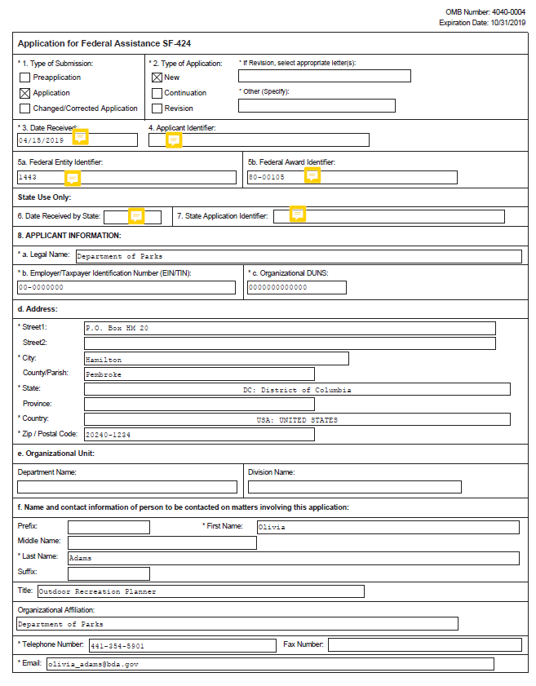
SF424
(p1)
NATIONAL ASSICATION OF STATE OUTDOOR RECREATION LIASON OFFICERS NASORLO.ORG

Slide 14
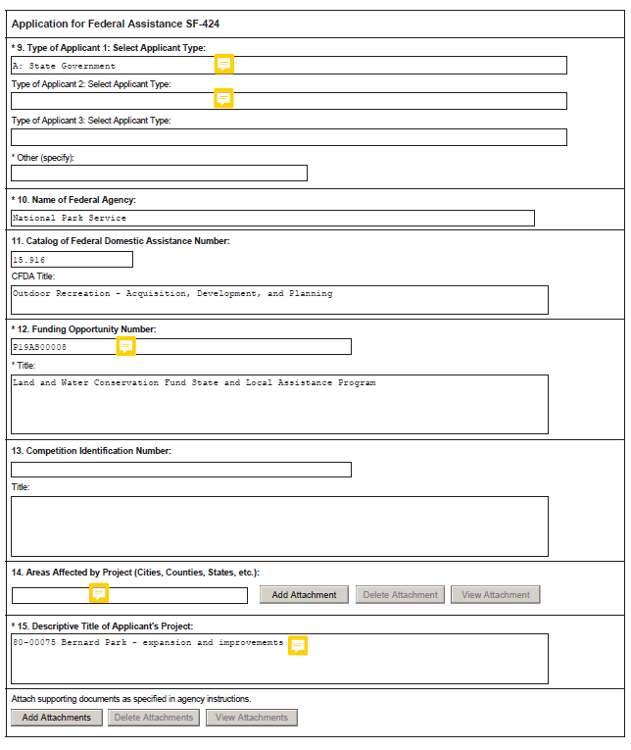
SF424
(p2)
NATIONAL ASSICATION OF STATE OUTDOOR RECREATION LIASON OFFICERS NASORLO.ORG

Slide 15
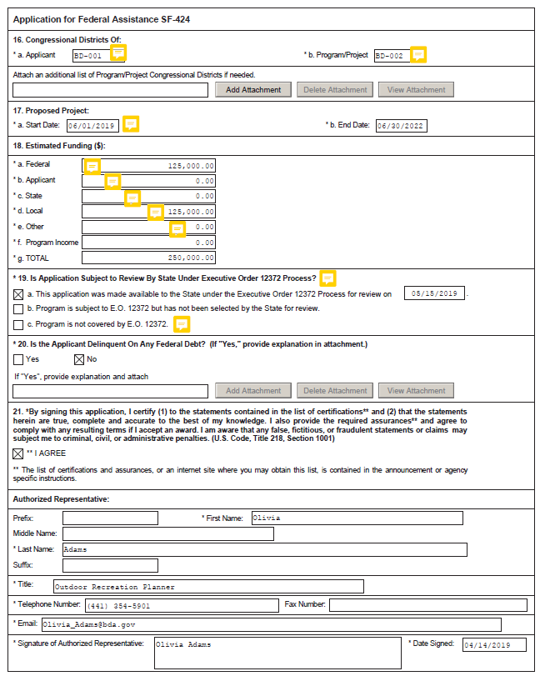
SF424
(p3)
NATIONAL ASSICATION OF STATE OUTDOOR RECREATION LIASON OFFICERS NASORLO.ORG

Slide 16
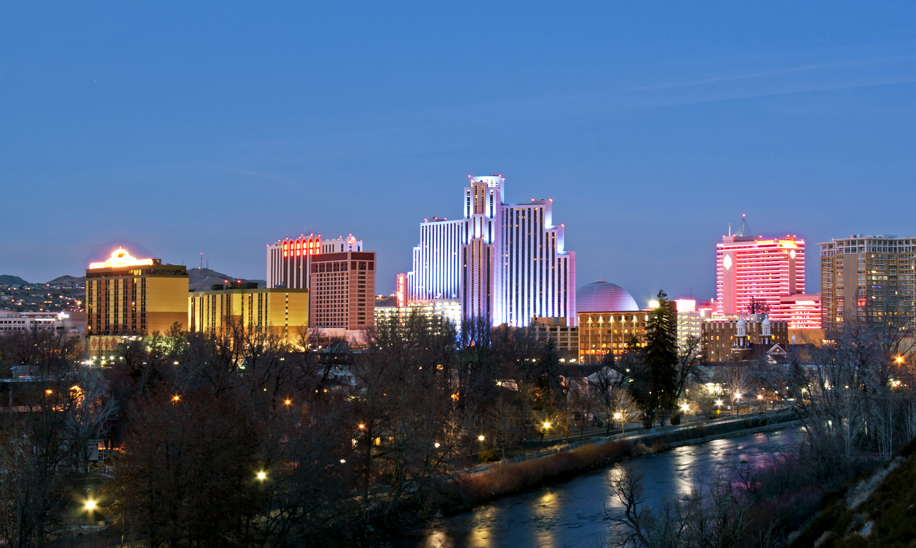
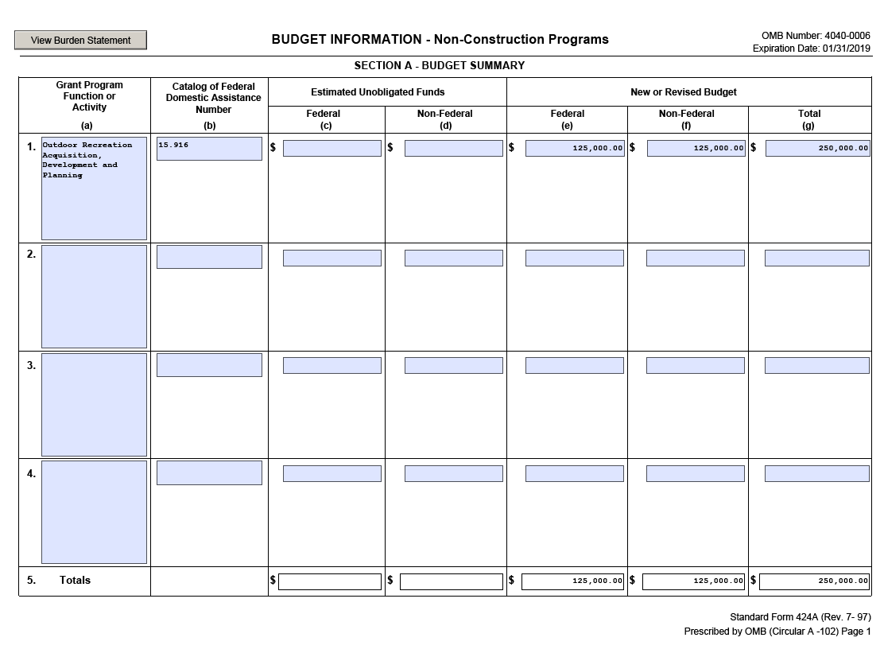
SF 424A (p1)
TEXT
NATIONAL ASSICATION OF STATE OUTDOOR RECREATION LIASON OFFICERS NASORLO.ORG

Slide 17
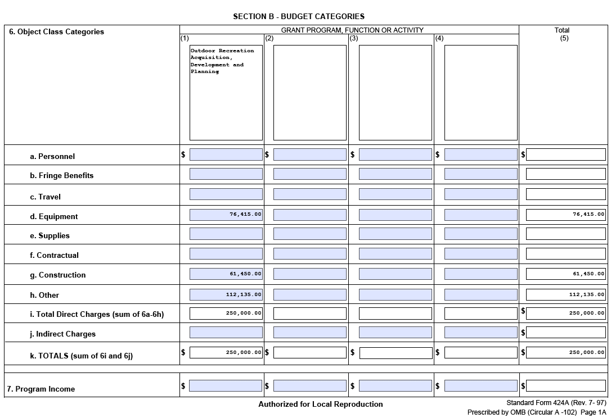
SF 424A (p2)
TEXT
NATIONAL ASSICATION OF STATE OUTDOOR RECREATION LIASON OFFICERS NASORLO.ORG

Slide 18
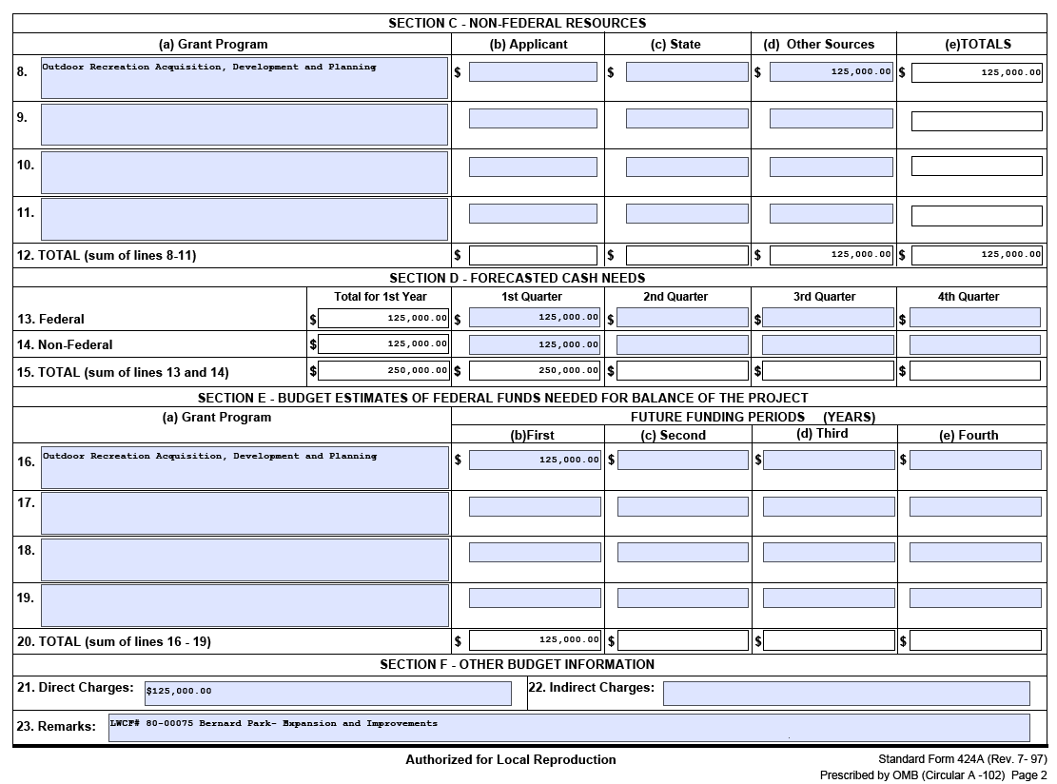
SF 424A (p3)
TEXT
NATIONAL ASSICATION OF STATE OUTDOOR RECREATION LIASON OFFICERS NASORLO.ORG

Slide 19
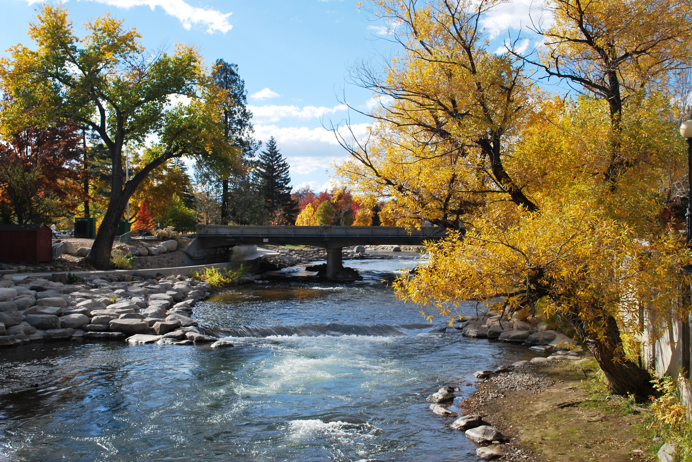
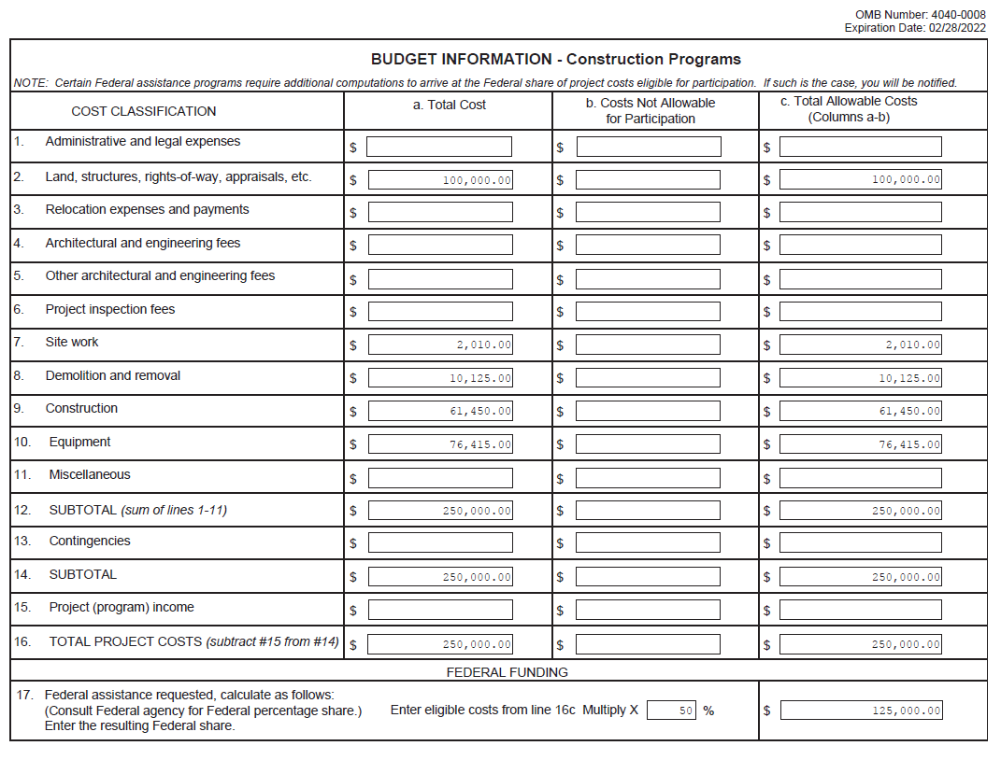
SF 424C
NATIONAL ASSICATION OF STATE OUTDOOR RECREATION LIASON OFFICERS NASORLO.ORG

Slide 20
SF 424C vs. Detailed Budget
TEXT
NATIONAL ASSICATION OF STATE OUTDOOR RECREATION LIASON OFFICERS NASORLO.ORG

Slide 21
SF 424C
TEXT
NATIONAL ASSICATION OF STATE OUTDOOR RECREATION LIASON OFFICERS NASORLO.ORG

Slide 22
SF 424C vs. Detailed Budget
TEXT
NATIONAL ASSICATION OF STATE OUTDOOR RECREATION LIASON OFFICERS NASORLO.ORG

Slide 23
SF 424C
TEXT
NATIONAL ASSICATION OF STATE OUTDOOR RECREATION LIASON OFFICERS NASORLO.ORG

Slide 24
SF 424C vs. Detailed Budget
TEXT
NATIONAL ASSICATION OF STATE OUTDOOR RECREATION LIASON OFFICERS NASORLO.ORG

Slide 25
SF 424C
TEXT
NATIONAL ASSICATION OF STATE OUTDOOR RECREATION LIASON OFFICERS NASORLO.ORG

Slide 26
SF 424C vs. Detailed Budget
TEXT
NATIONAL ASSICATION OF STATE OUTDOOR RECREATION LIASON OFFICERS NASORLO.ORG

Slide 27
SF 424C
TEXT
NATIONAL ASSICATION OF STATE OUTDOOR RECREATION LIASON OFFICERS NASORLO.ORG

Slide 28
SF 424C vs. Detailed Budget
TEXT
NATIONAL ASSICATION OF STATE OUTDOOR RECREATION LIASON OFFICERS NASORLO.ORG

Slide 29
SF 424C
TEXT
NATIONAL ASSICATION OF STATE OUTDOOR RECREATION LIASON OFFICERS NASORLO.ORG

Slide 30
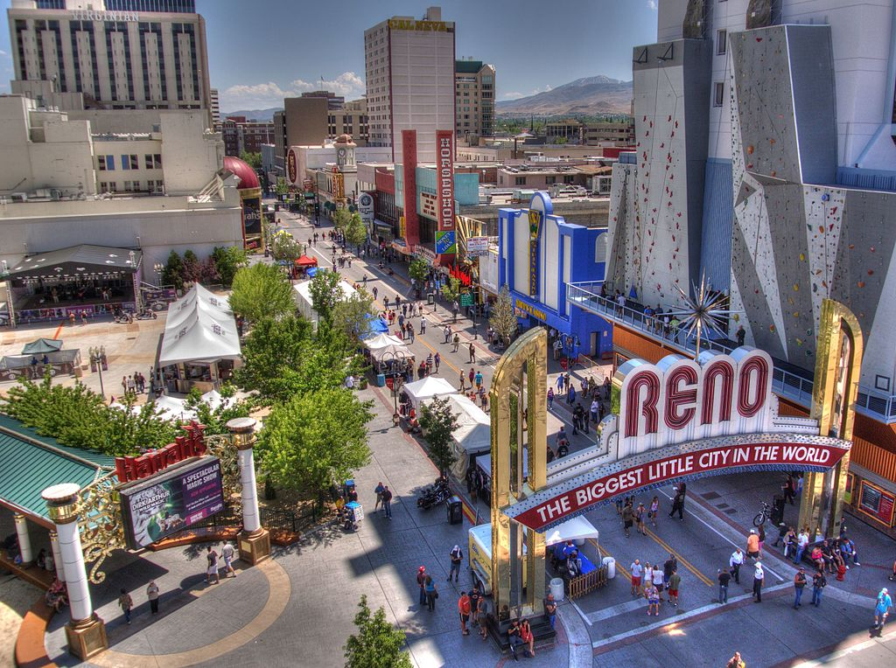
QUESTIONS?
NATIONAL ASSICATION OF STATE OUTDOOR RECREATION LIASON OFFICERS NASORLO.ORG

Slide 31


Georgia
New Hampshire
Antoinette Norfleet
Grants Program Manager
Antoinette.Norfleet@dnr.ga.gov
770-389-7264
https://gadnr.org/LWCF
Eric Feldbaum
Director of Community Recreation
Eric.Feldbaum@dncr.nh.gov
603-271-3008
www.nhstateparks.org
NATIONAL ASSICATION OF STATE OUTDOOR RECREATION LIASON OFFICERS NASORLO.ORG

