Slide 1
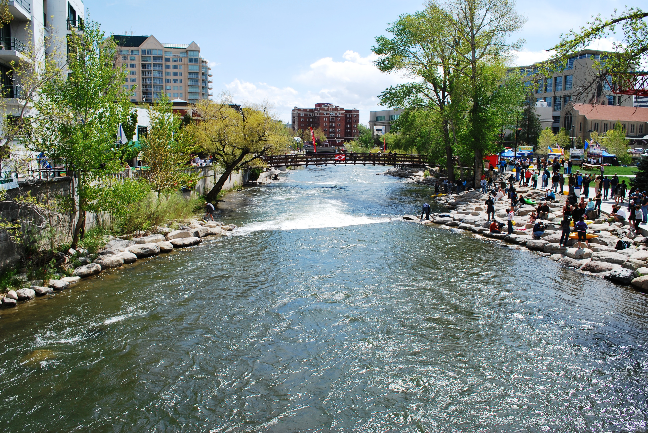

HOW TO CREATE A 6(f) PROJECT MAP WITH NON-TECHNICAL SKILLS
2019 NASORLO Conference
Reno, Nevada

Slide 2
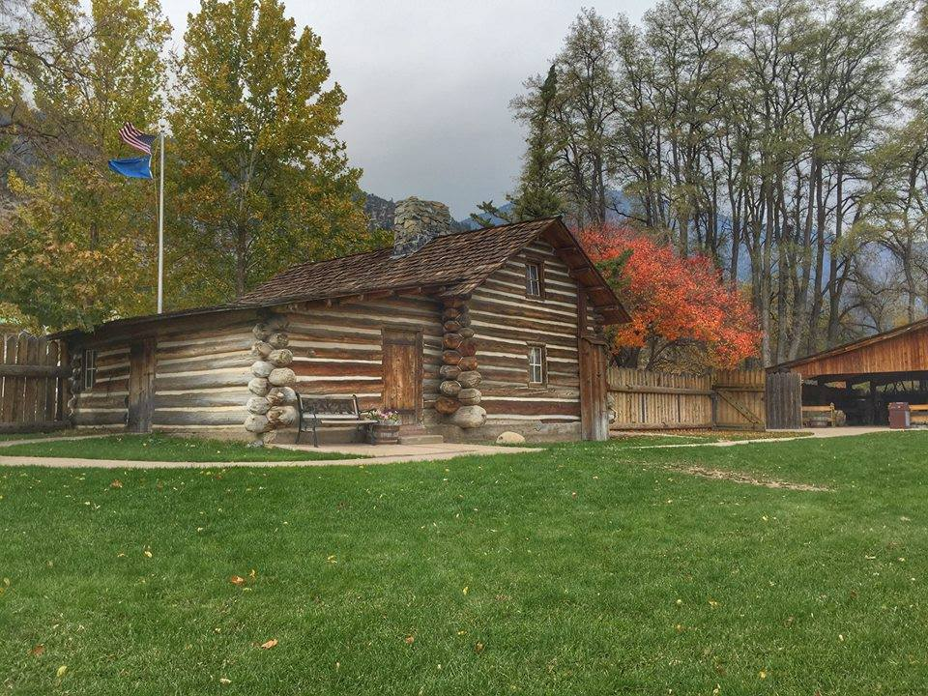

Featuring
Making a map for a new site
Making a map for previously fund assisted site
NATIONAL ASSICATION OF STATE OUTDOOR RECREATION LIASON OFFICERS NASORLO.ORG

Slide 3
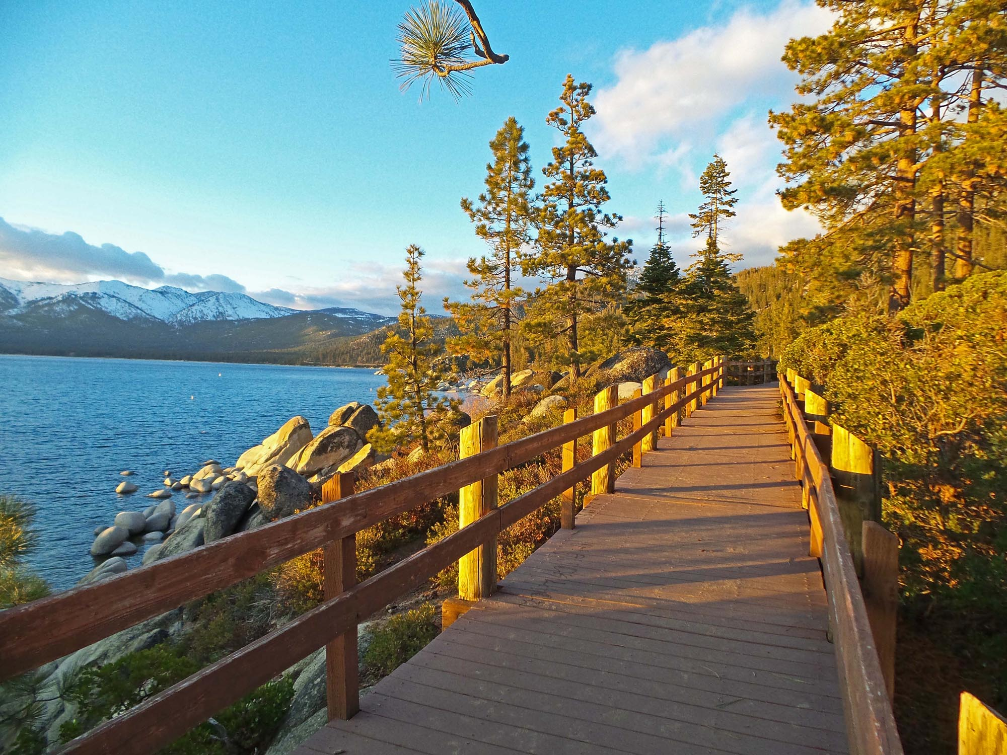
New Projects
With few exceptions, the default for any new project boundary will be the entirety of the existing parcel.
If local – have them propose the boundary map
If state – start with best known parcel boundary map.
NATIONAL ASSICATION OF STATE OUTDOOR RECREATION LIASON OFFICERS NASORLO.ORG

Slide 4
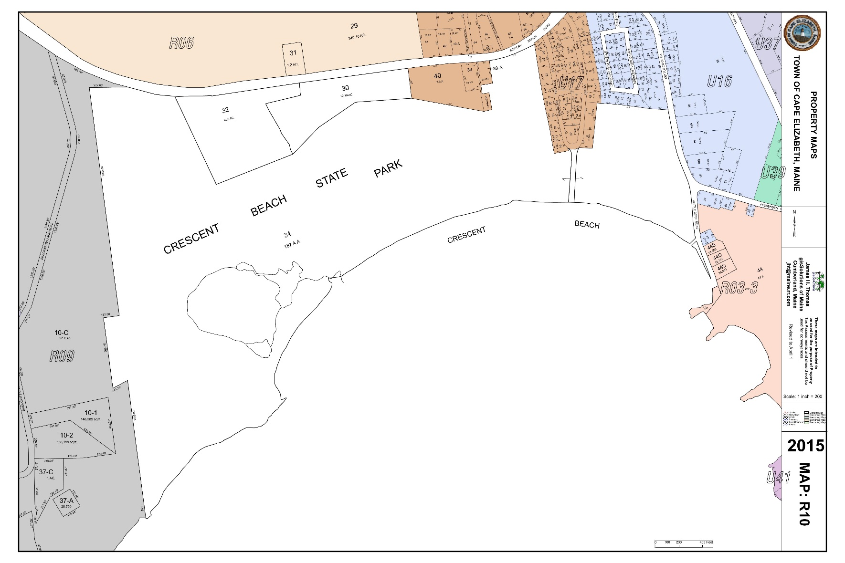
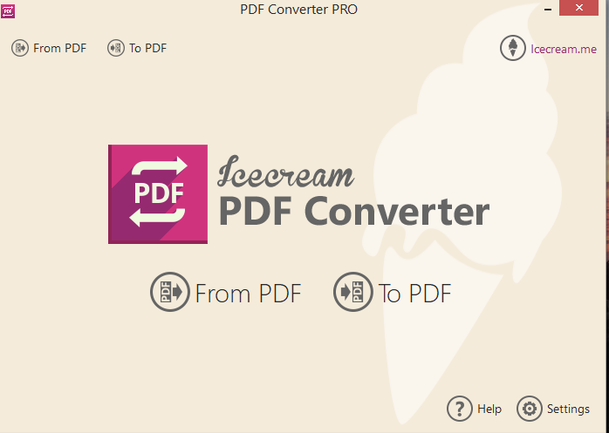
Simple Steps To Map Success
1 – Take pdf file and convert to jpg. I use IceCream
NATIONAL ASSICATION OF STATE OUTDOOR RECREATION LIASON OFFICERS NASORLO.ORG

Slide 5
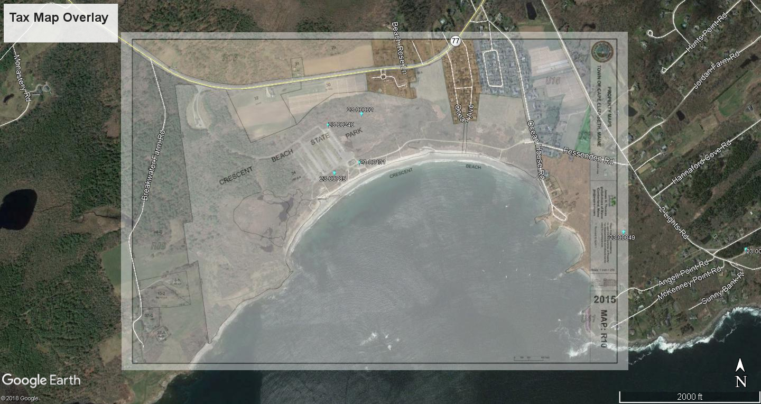
Simple Steps To Map Success
2 – Overlay map in Google Earth
Make overlay transparent enough to see key land features through map to align landmarks.
Hold SHIFT key while resizing to keep perspective
By drawing a polygon around the border you can obtain total acreage
Save result as picture for next step.
NATIONAL ASSICATION OF STATE OUTDOOR RECREATION LIASON OFFICERS NASORLO.ORG

Slide 6
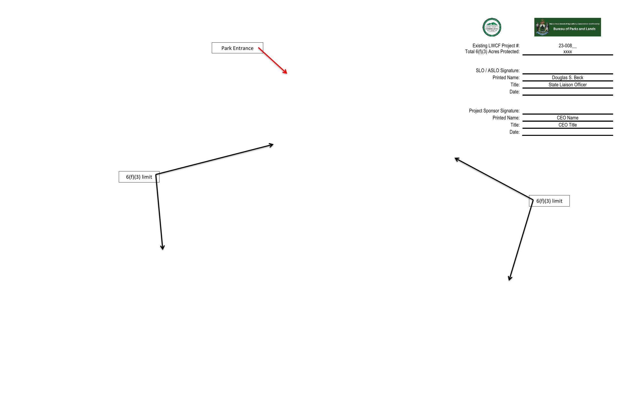
Simple Steps To Map Success
3 – Create word document to complete map.
Again, I use a template with signature block imbedded, and basic components to start final process.
NATIONAL ASSICATION OF STATE OUTDOOR RECREATION LIASON OFFICERS NASORLO.ORG

Slide 7
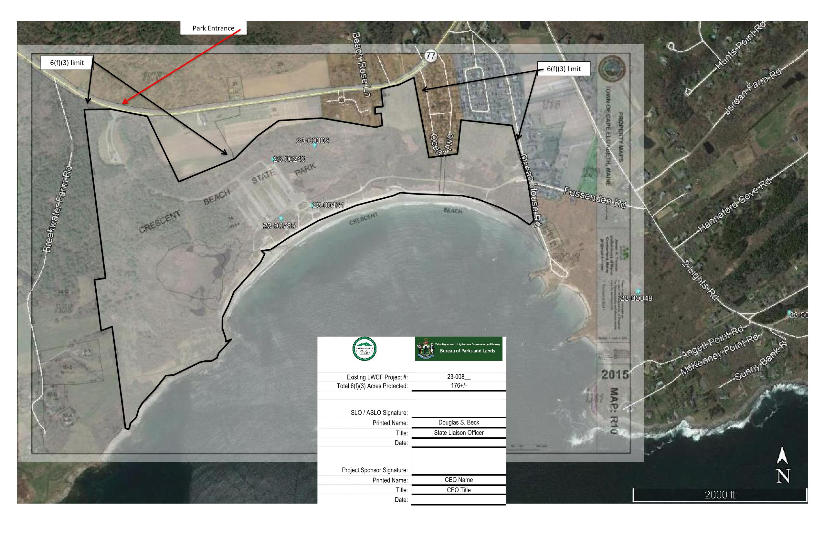
Simple Steps To Map Success
3 – Once imported into word you can add text boxes, arrows and other graphics to identify key features of the landscape and project area for future reference.
NATIONAL ASSICATION OF STATE OUTDOOR RECREATION LIASON OFFICERS NASORLO.ORG

Slide 8
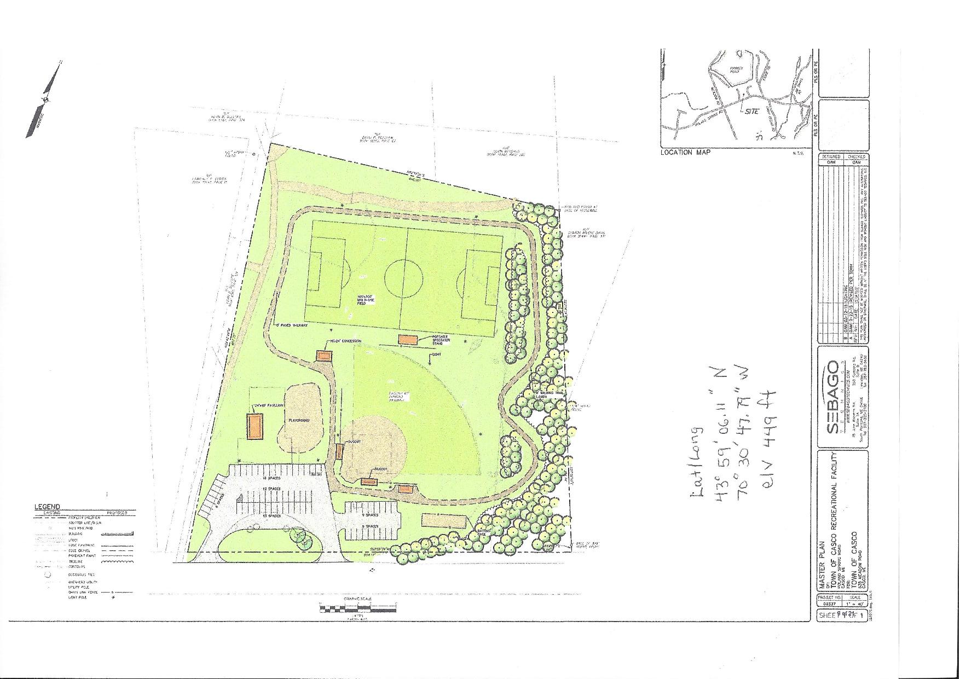
New park map development
New Local Project – Casco Memorial Park
Sponsor suggested map.
Need to convert pdf to jpg in order to import as a layer on Google Earth
NATIONAL ASSICATION OF STATE OUTDOOR RECREATION LIASON OFFICERS NASORLO.ORG

Slide 9
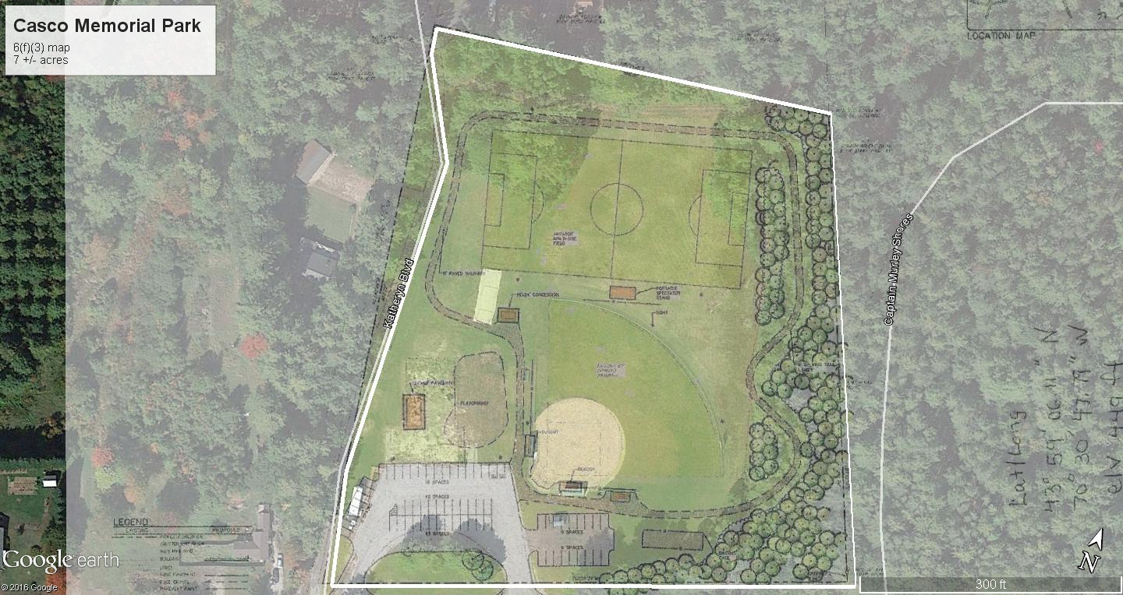
Overlay look
New Local Project – Casco Memorial Park
Use best option to merge onto GE image of site
After aligning document to ground realities. Save image as jpg for use next.
NATIONAL ASSICATION OF STATE OUTDOOR RECREATION LIASON OFFICERS NASORLO.ORG

Slide 10
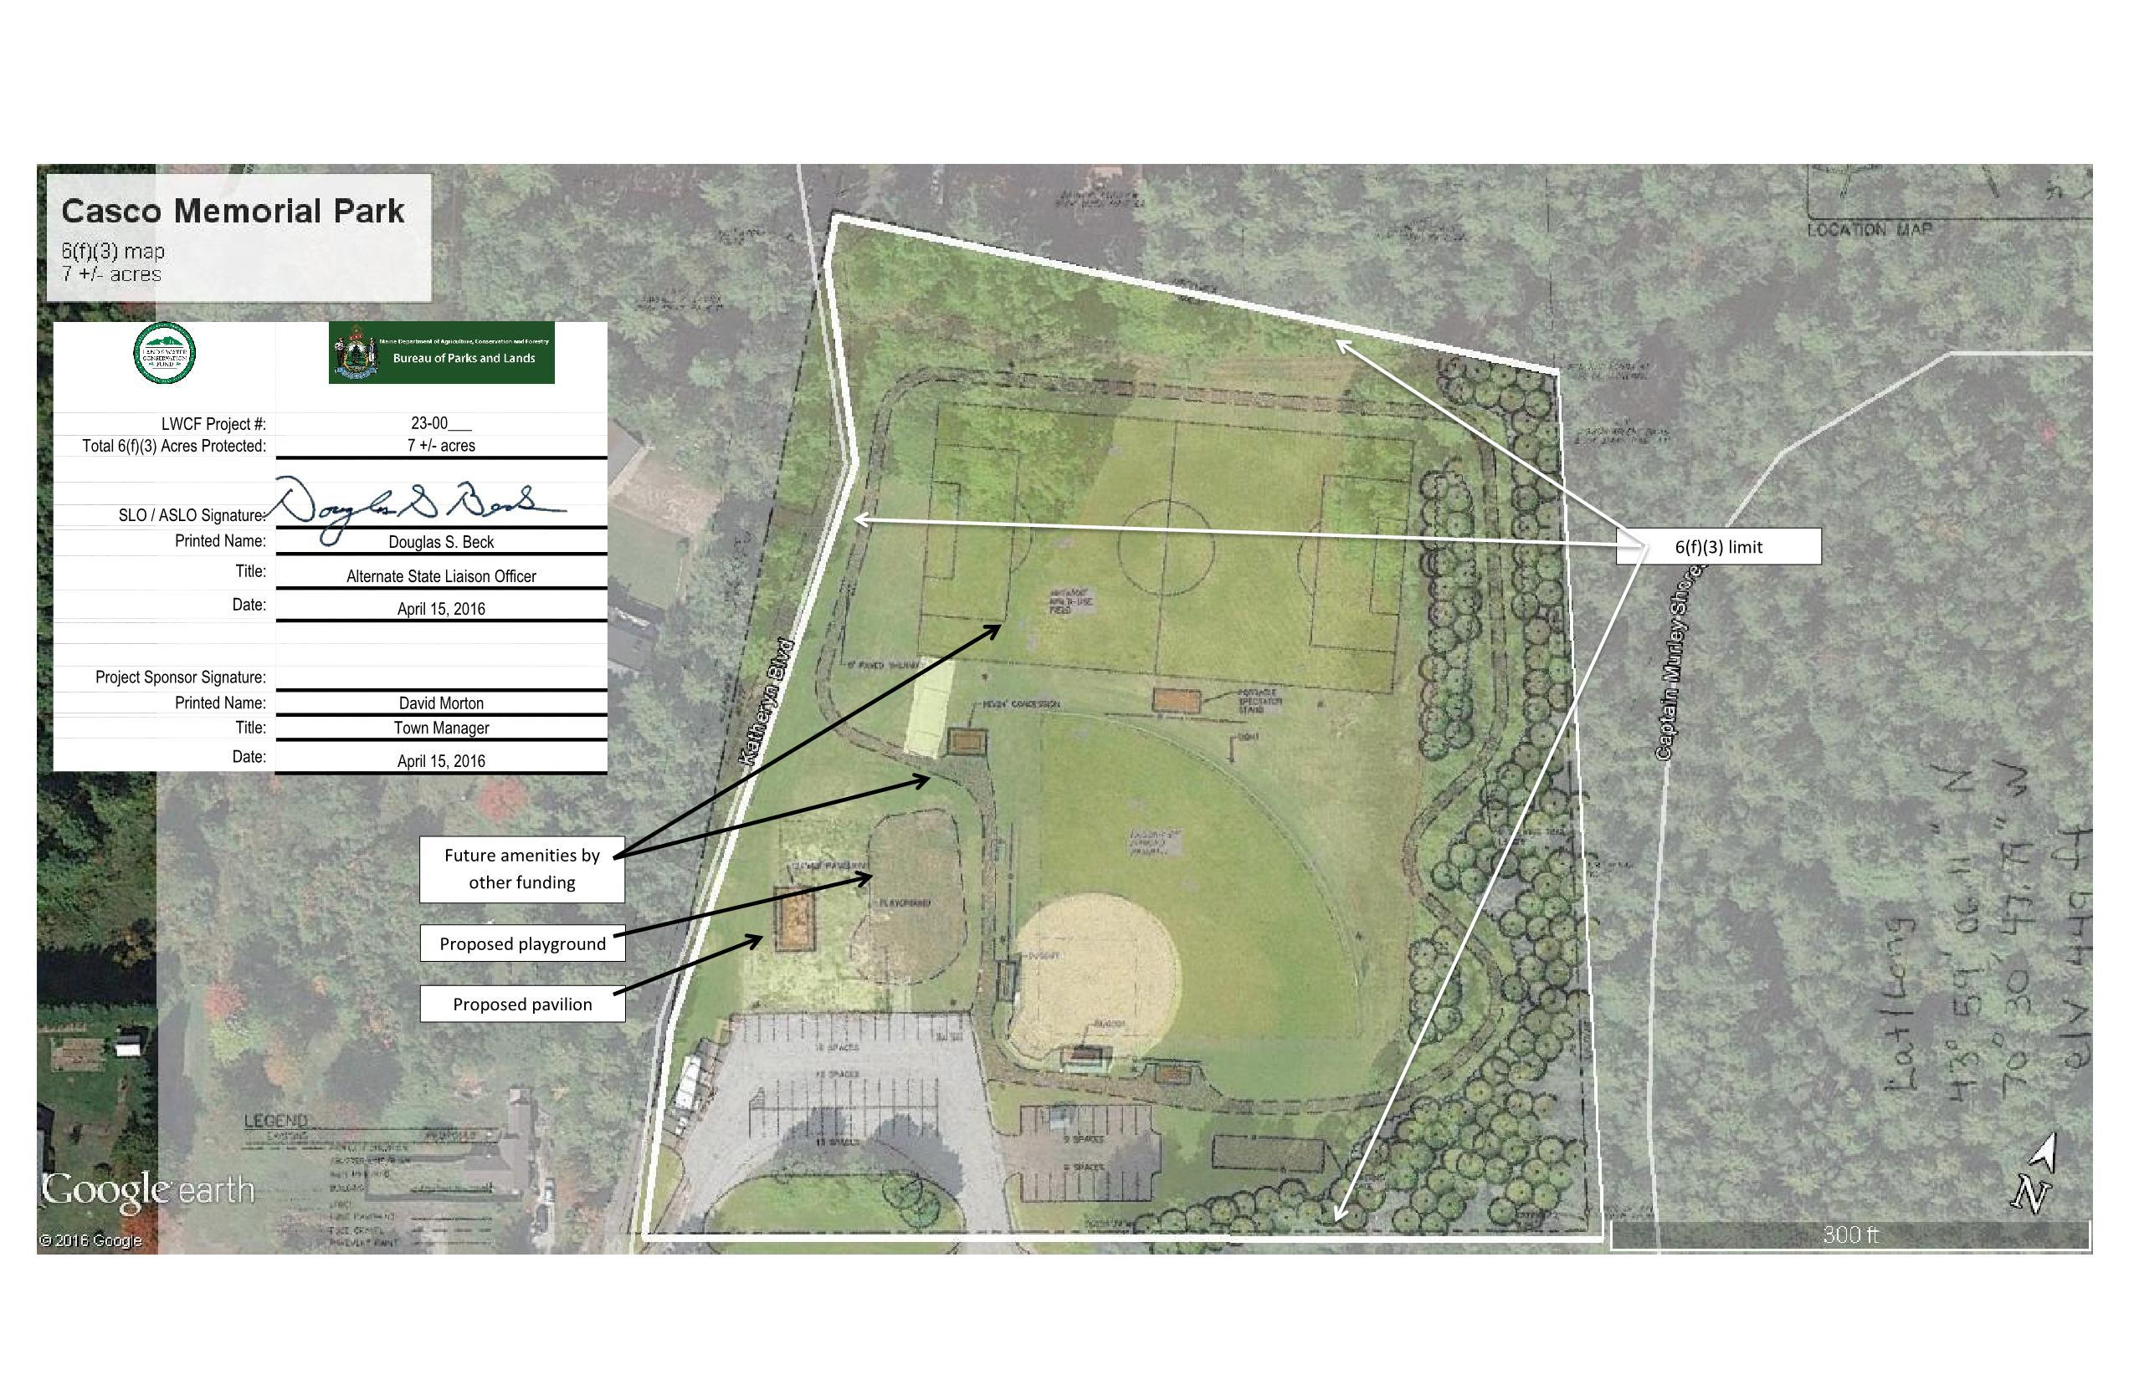
Label Key Elements
New Local Project – Casco Memorial Park
Add jpg file generated in Google Earth to a word document to add labels, arrows, and key identification elements. Be sure to include North arrow, acreage and signature block
I maintain a general word template complete with sig block.
NATIONAL ASSICATION OF STATE OUTDOOR RECREATION LIASON OFFICERS NASORLO.ORG

Slide 11
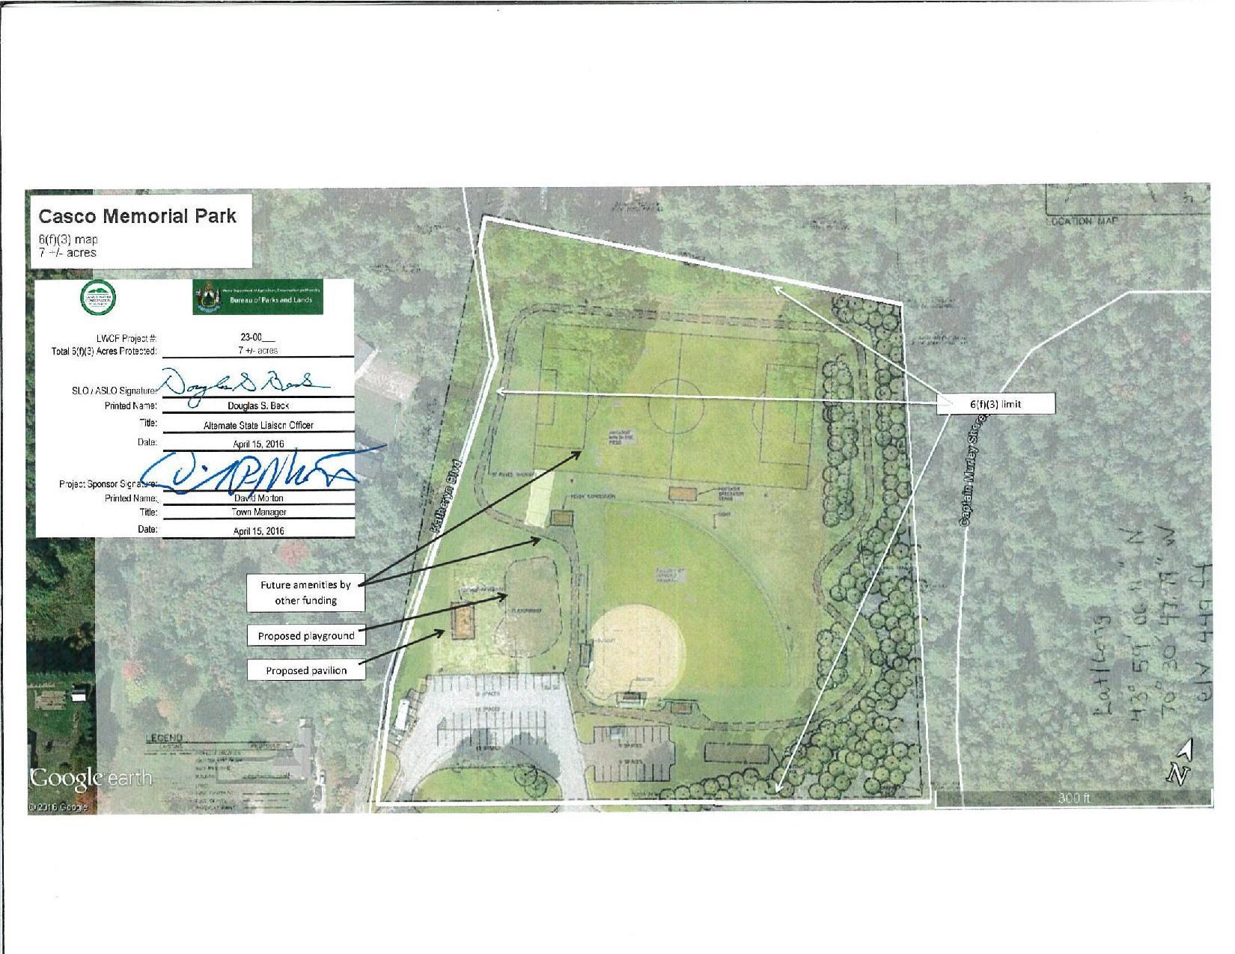
Local signature
New Local Project – Casco Memorial Park
Sponsor signs to confirm and secure understanding of what area is protected.
Note- project number not complete as this was submitted at time of application.
Revised map sent at closeout.
NATIONAL ASSICATION OF STATE OUTDOOR RECREATION LIASON OFFICERS NASORLO.ORG

Slide 12
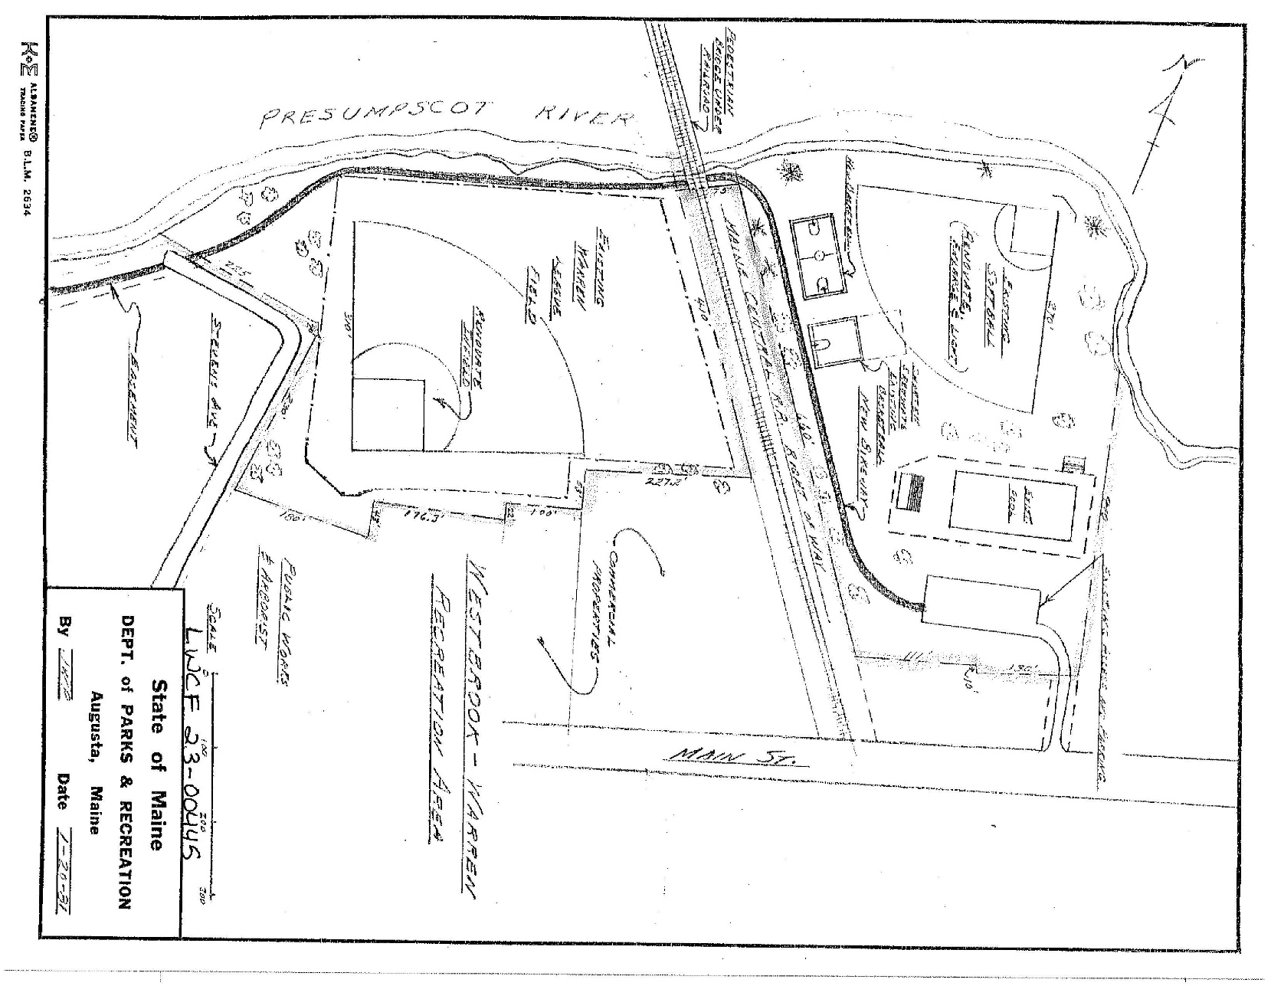
Updating maps for previously funded sites
Adding protected area to a previously fund assisted site.
Local project sponsor wants to rehabilitate the site.
This is the existing 6(f) map
NATIONAL ASSICATION OF STATE OUTDOOR RECREATION LIASON OFFICERS NASORLO.ORG

Slide 13
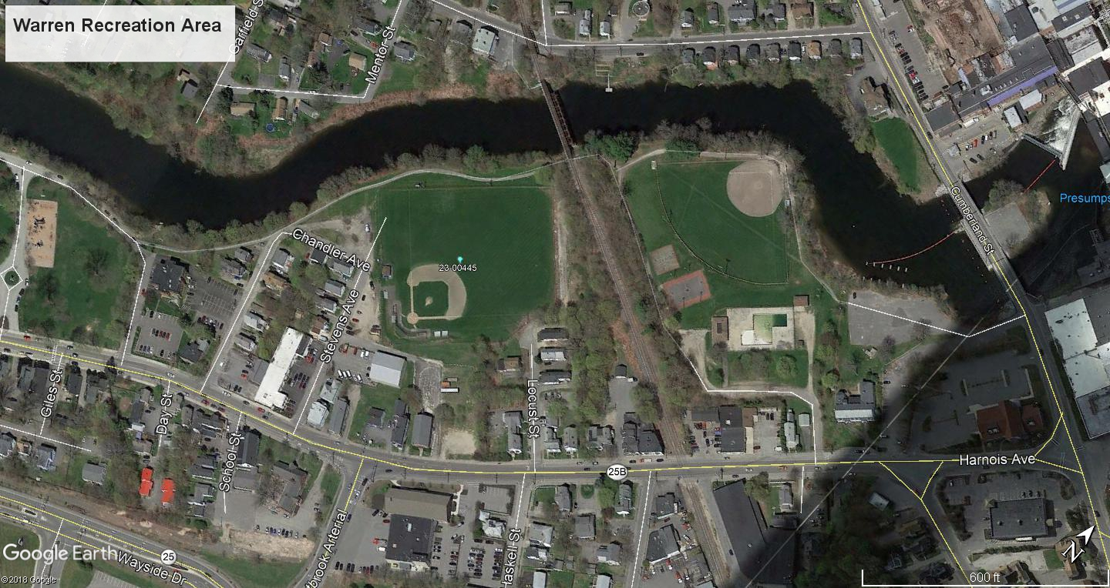
Updating maps for previously funded sites
Note that the original grant’s related 6(f) boundary only captured the baseball field receiving funding assistance, not the entire facility.
New funding will benefit the entire area.
NATIONAL ASSICATION OF STATE OUTDOOR RECREATION LIASON OFFICERS NASORLO.ORG

Slide 14
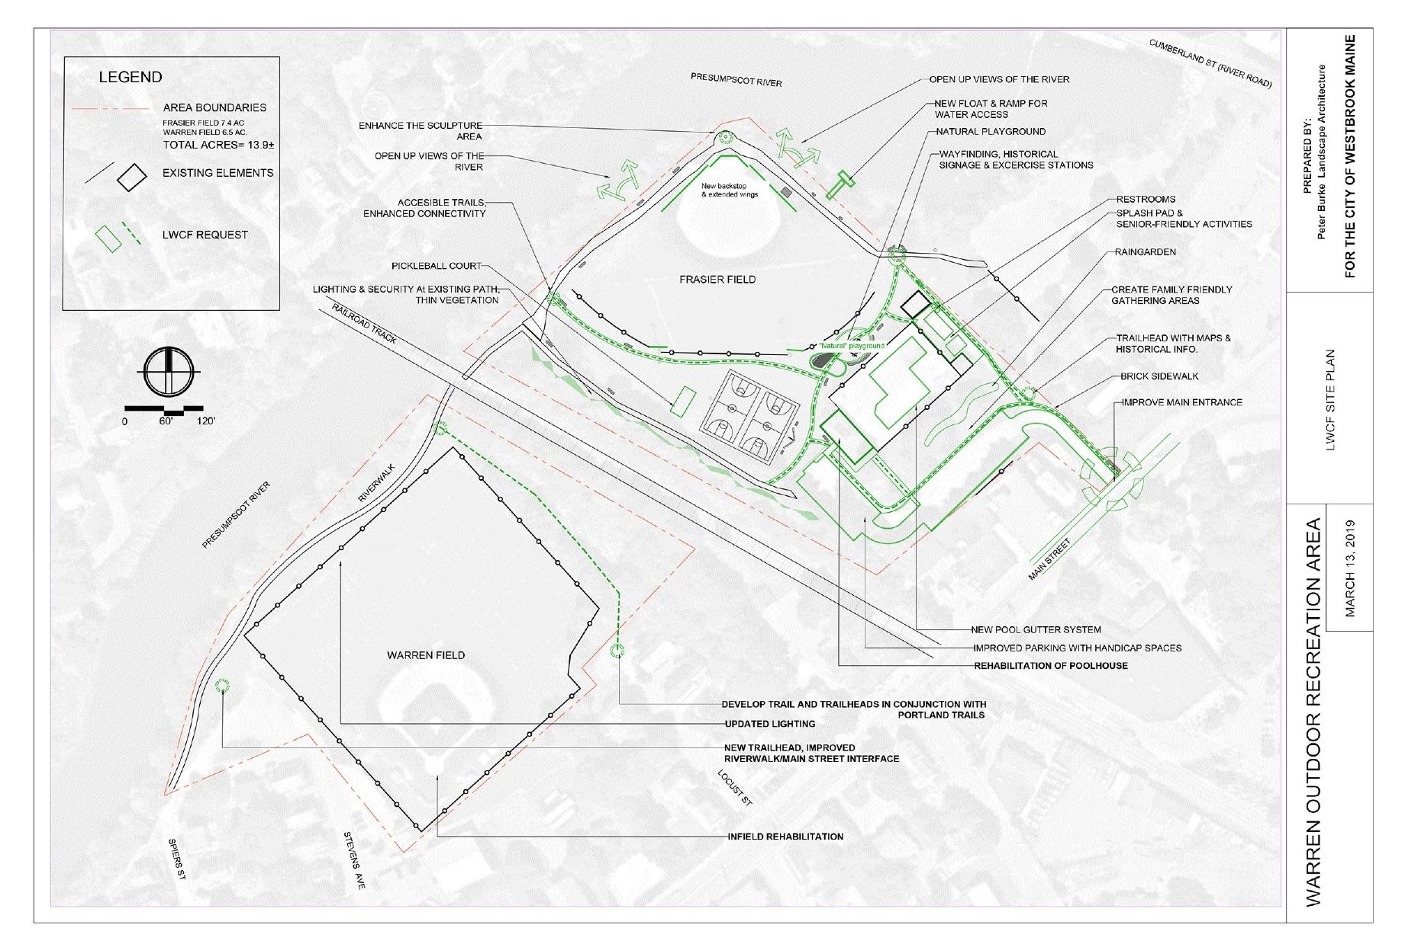
Updating maps for previously funded sites
Sponsor provided site map needs to be modified to add all key components
NATIONAL ASSICATION OF STATE OUTDOOR RECREATION LIASON OFFICERS NASORLO.ORG

Slide 15
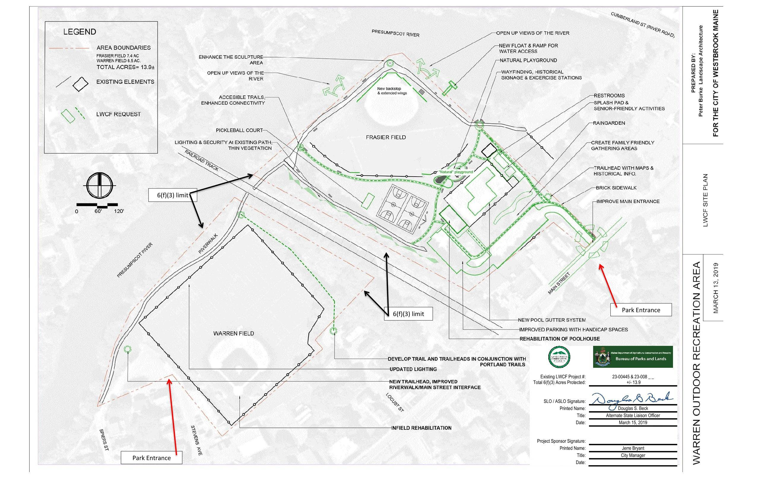
Updating maps for previously funded sites
Sponsor provided site map needs to be modified to add all key components
NATIONAL ASSICATION OF STATE OUTDOOR RECREATION LIASON OFFICERS NASORLO.ORG

Slide 16

Sign it
Seal it
Deliver it
Best practice would be to have the parcel surveyed and tied to permanent landmarks / pins on the ground. This is something we hope to implement in the next round of grants.
Getting signatures at time of application are good to assure up front confirmation of parcel size. If any changes by end of project, update map and obtain new signatures.
NATIONAL ASSICATION OF STATE OUTDOOR RECREATION LIASON OFFICERS NASORLO.ORG

Slide 17
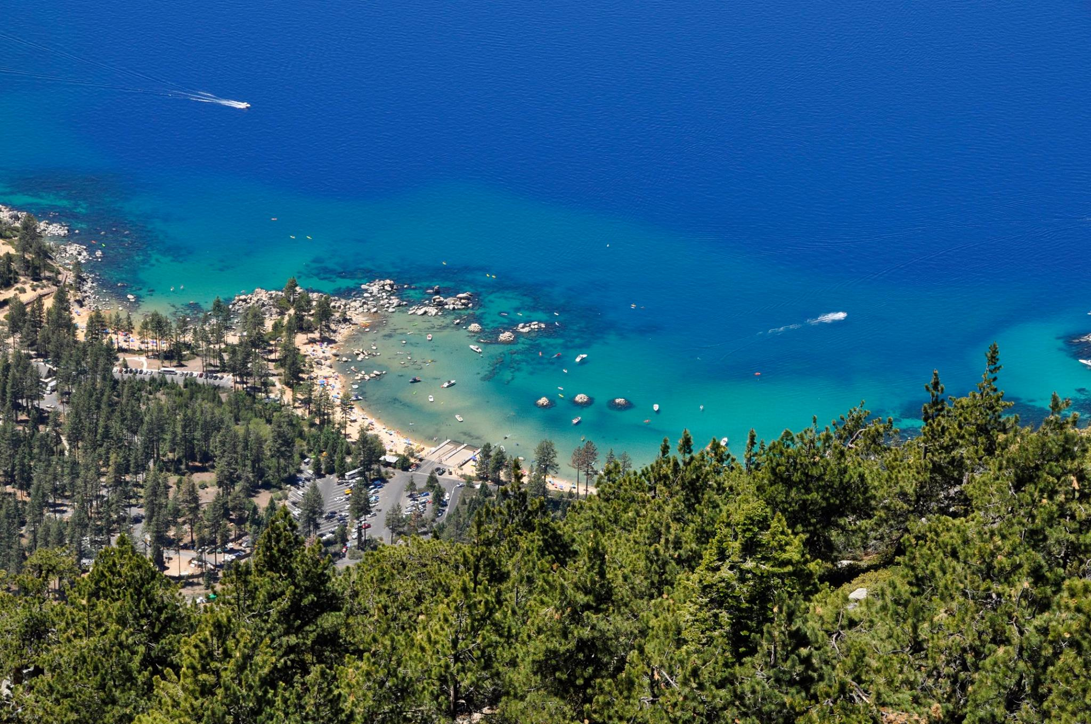
QUESTIONS?
NATIONAL ASSICATION OF STATE OUTDOOR RECREATION LIASON OFFICERS NASORLO.ORG

Slide 18
Maine
Douglas S. Beck
Outdoor Recreation Supervisor
Doug.beck@maine.gov
207-624-6090
https://www.maine.gov/dacf/parks/about/grants.shtml
NATIONAL ASSICATION OF STATE OUTDOOR RECREATION LIASON OFFICERS NASORLO.ORG

